Slide 1
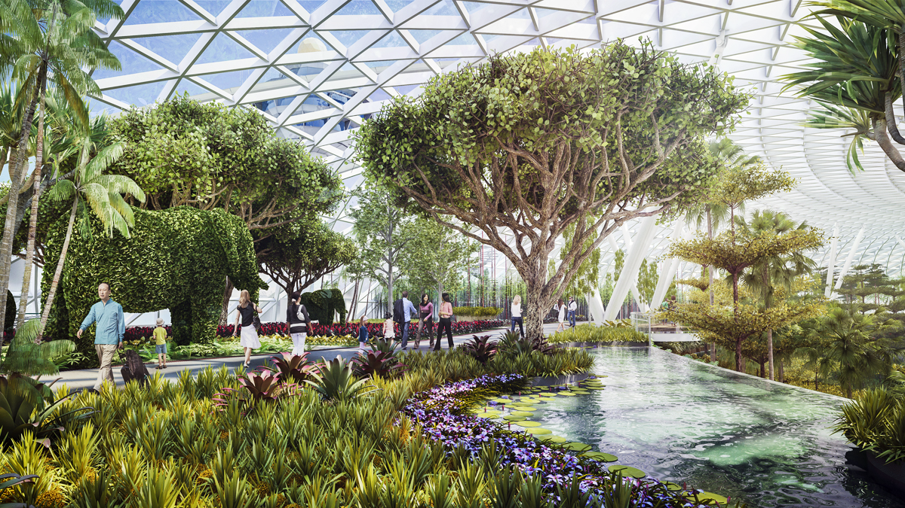
CHANGI GREEN AIRPORT
Karen Tambayong
Green City Committee
International Association of Horticultural Producers

Slide 2
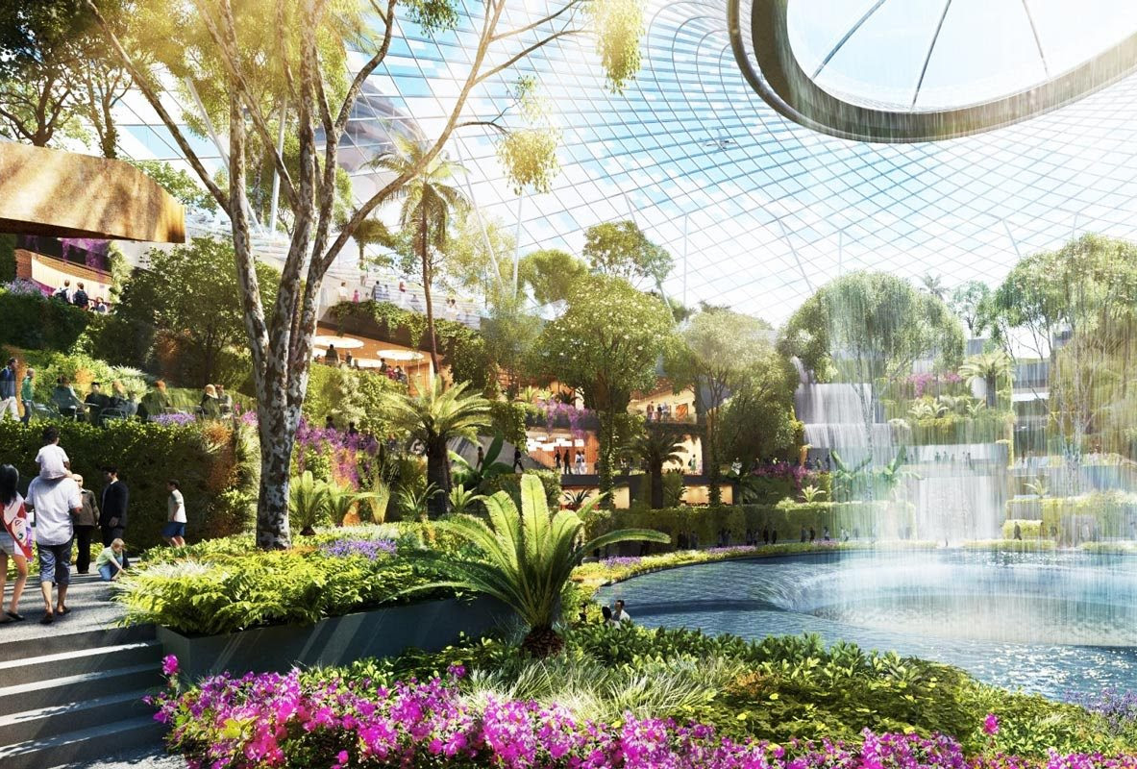
CHANGI AIRPORT
Have 500.000 plants, a horticulture team, and many gardens.
haroldmagazine.com

Slide 3
CRITERIA GREEN AIRPORT
Re-Using Construction Material
Air Conditioning, Water, and Light
Communications Facilities
Minimizing Construction Waste
Adopting Crushed Granural
Concrete Material
www.airport-technology.com
www.rougemagz.com

Slide 4
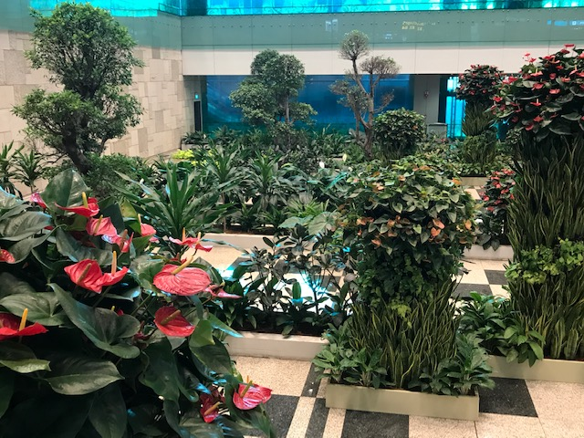
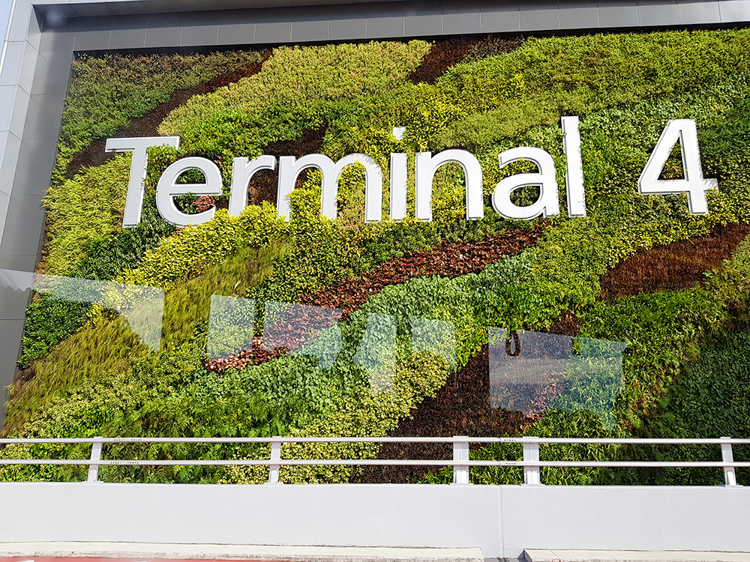
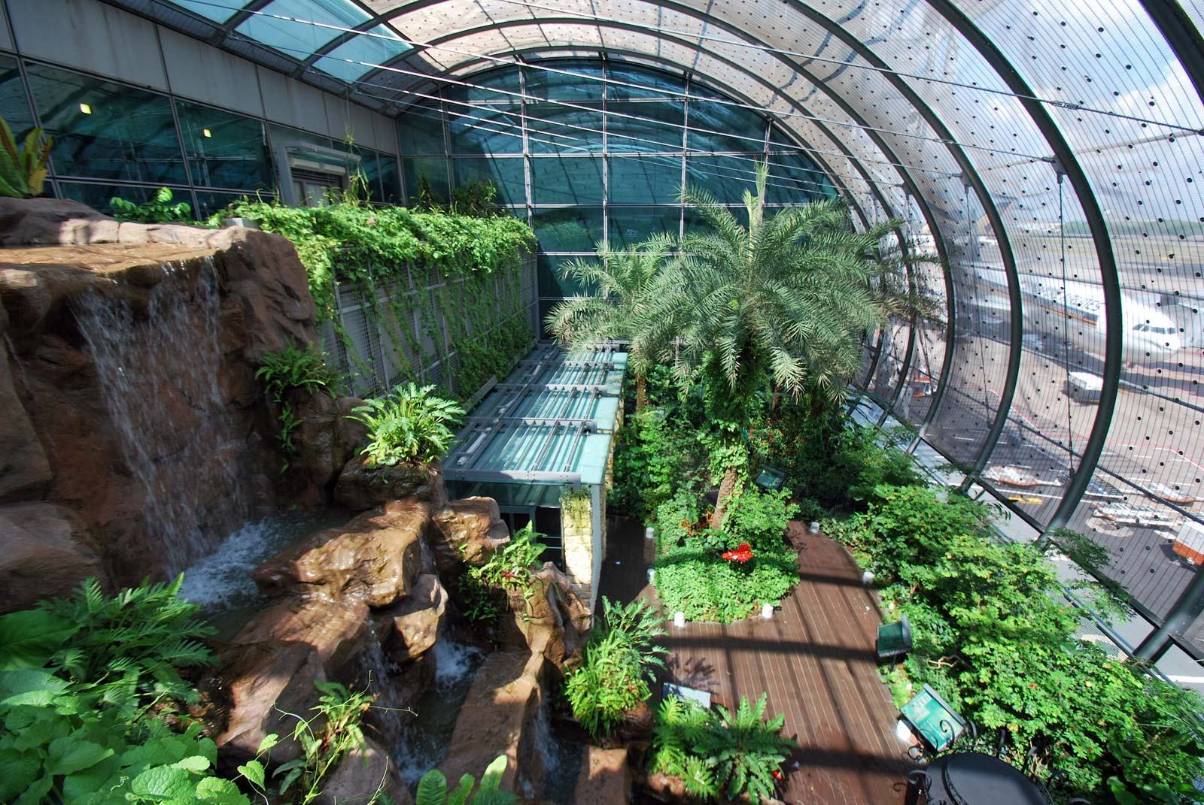
ENVIRONMENTALLY FRIENDLY AIRPORT
Commitment to green principles
Skylight to boost natural light
Air conditioners positioned nearer to the floor
Abundance of greenery
Energy efficient motion sensors
Energy efficient lighting
Water efficient fittings
Roof mounted solar panels
www.airport-technology.com
Karen T
changiairport.com
www. glaizabernaldez.com
www.vogue.com

Slide 5
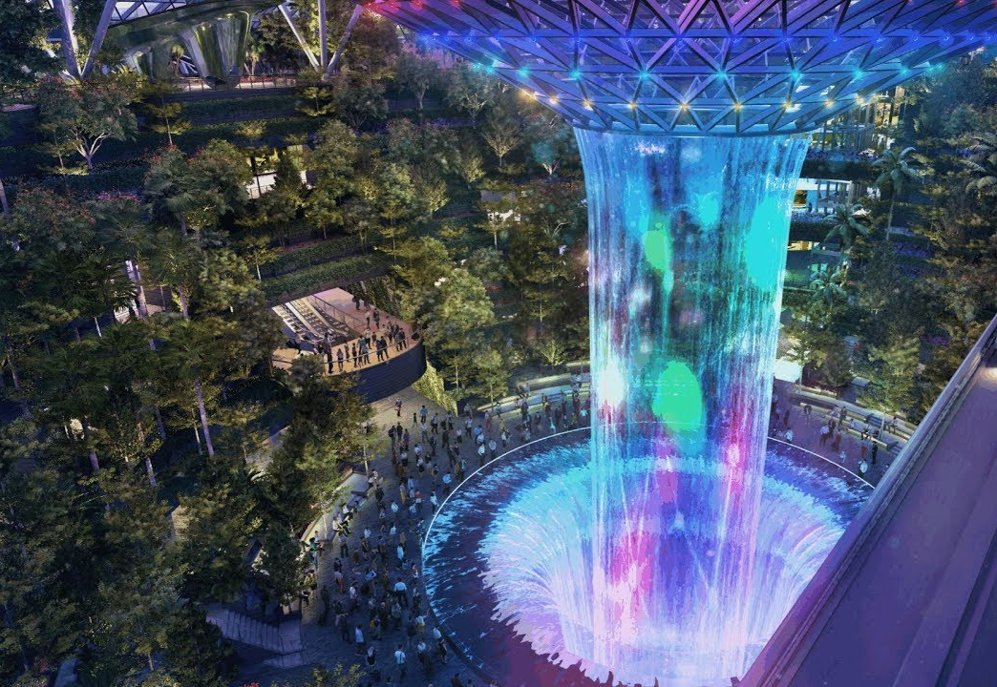
TERMINAL ATTRACTION
Terminal 1
Cactus Garden, Water Lily Garden,
Jewel Changi Airport
Terminal 2
Orchid Garden
Sunflower Garden, Fern Garden
Terminal 3
Butterfly Garden, Vertical Garden
Terminal 4
Steel in Bloom
Smoking Area located in all
terminals
Events
Horticulture display
Harry Potter Wonderland
Christmas event - Winter Wonderland
Valentine’s Day Dinner
Elizabeth Arden White Tea House
realseolinks.com

Slide 6
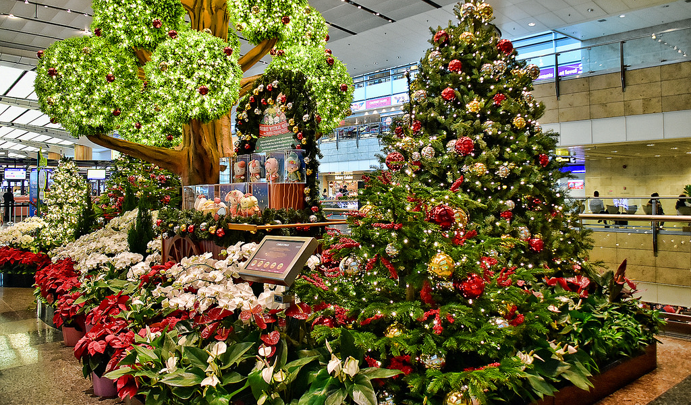
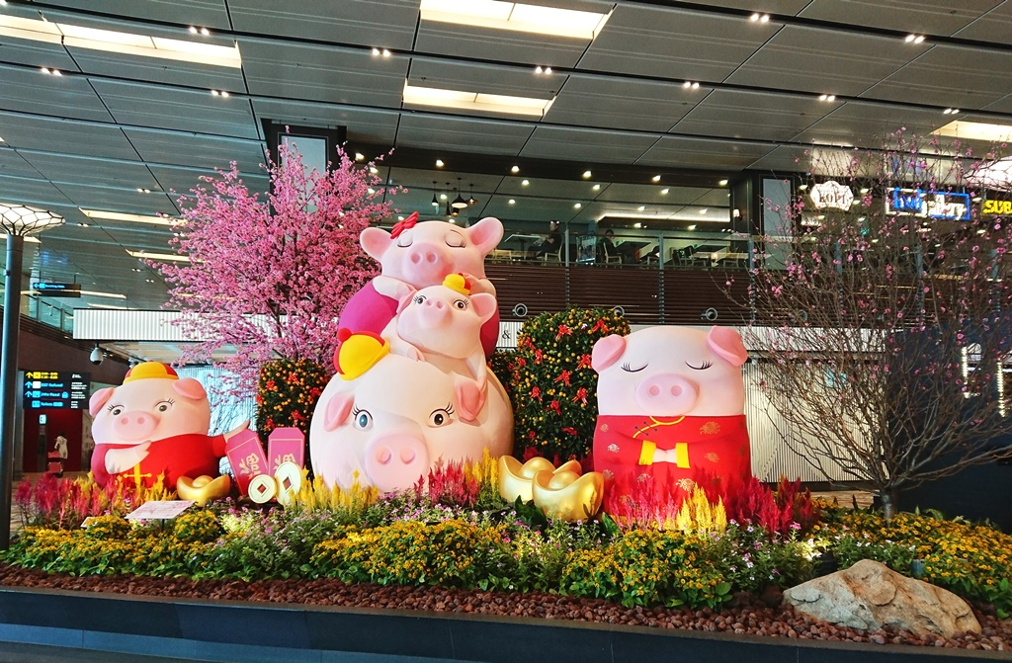
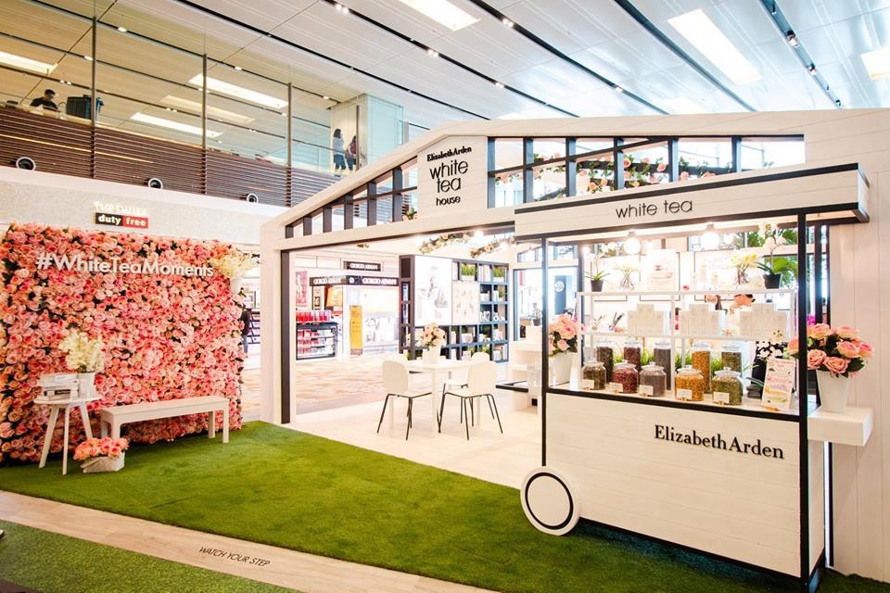
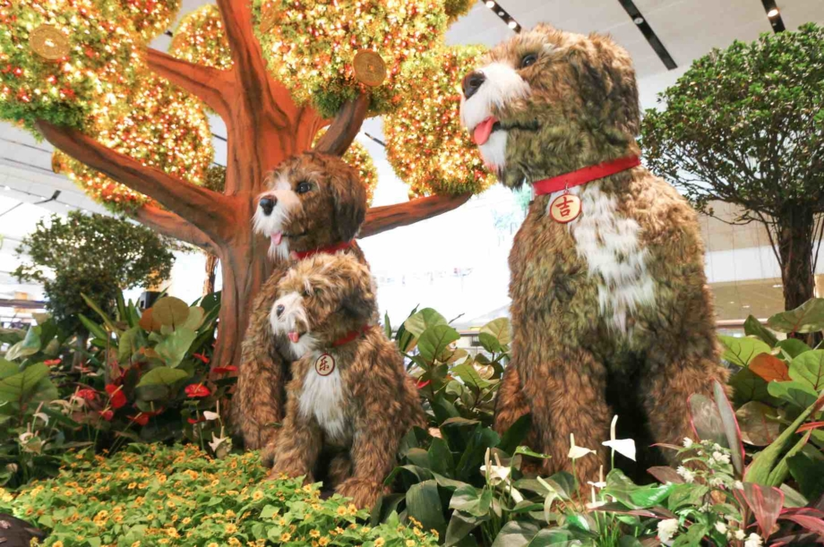
TERMINAL ATTRACTION
flickr.com
changiairport.com
Christmas Event
Horticulture Display
changiairport.com
www.aspirantsg.com
Elizabeth Arden White Tea House
Horticulture Display

Slide 7
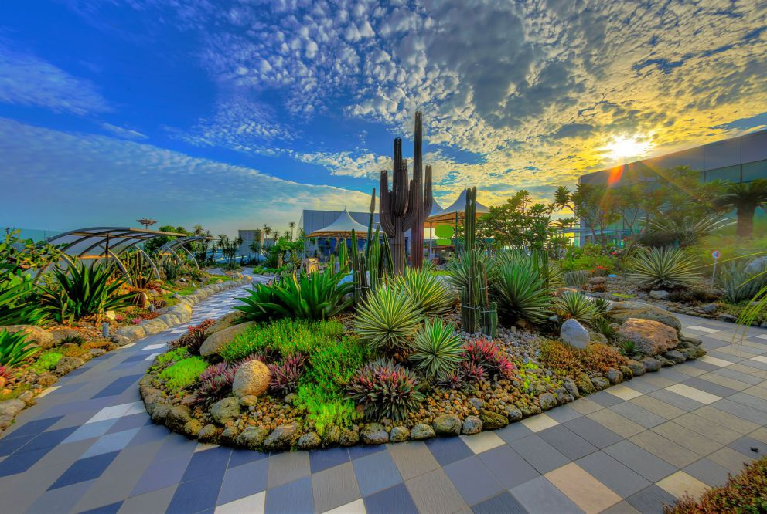
CACTUS GARDEN (T1)
lepl.com.sg
More than 100 species of cacti and arid plants
Various forms of Cycads and other surreal plants

Slide 8
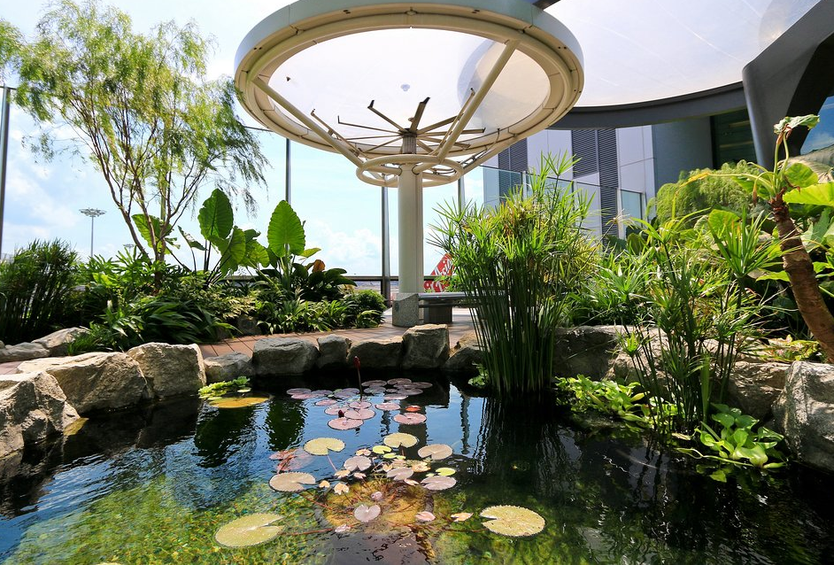
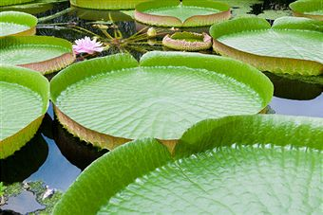
WATER LILY GARDEN (T1)
Water lilies in a natural aquatic garden environment.
These plants include the Amazon Water Lily, the Sacred Lotus and Screw pine.
weebly.com
twitter.com/ChangiAirport

Slide 9
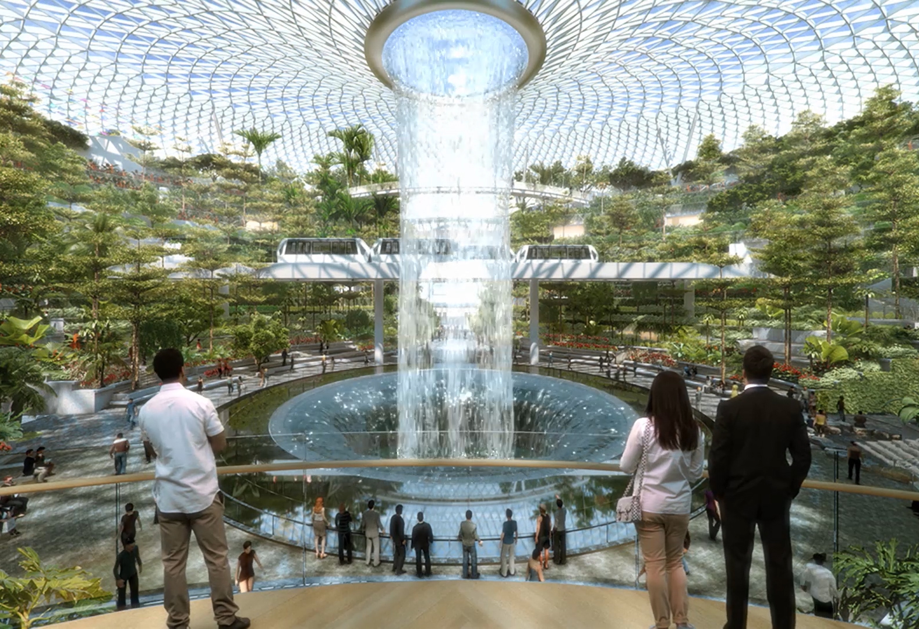
JEWEL CHANGI AIRPORT (T1)
www.changiairport.com
Under construction. Scheduled to open in April 17, 2019
Site Area: 3.5 hectares with 2,500 trees and 100,000 shrubs
Architecture Firms: RSP Architects Planners & Engineers (Pte) Ltd, in association with Safdie Architects
www.constructionplusasia.com

Slide 10
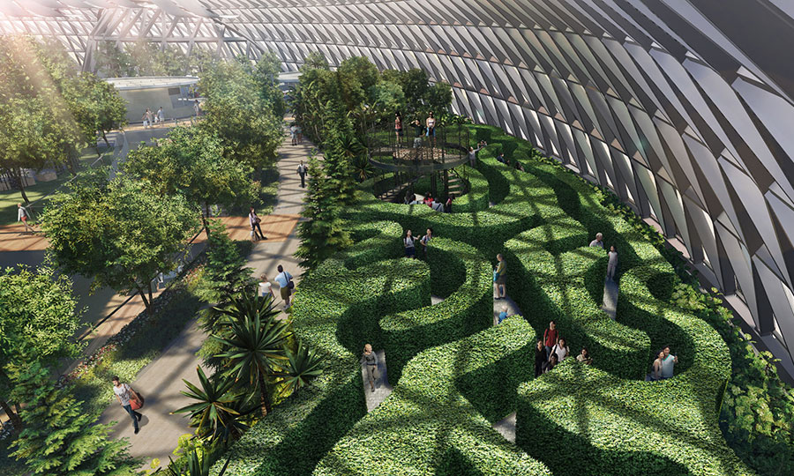
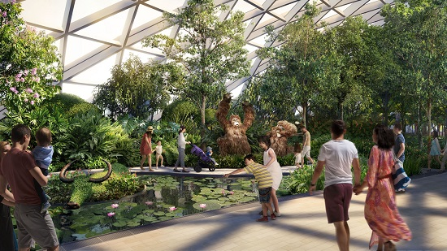
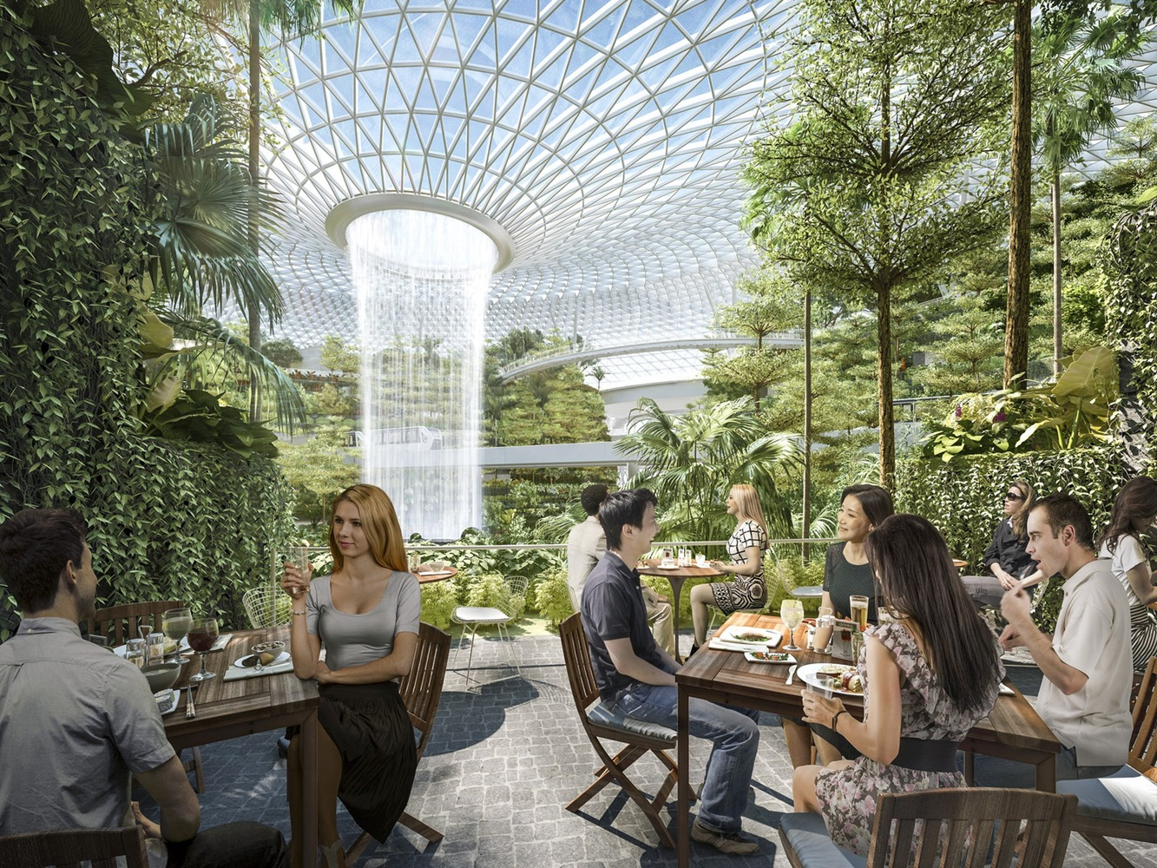
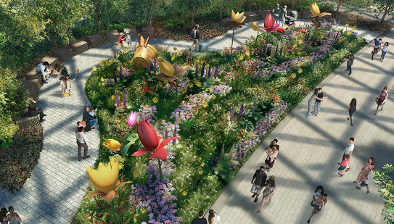
JEWEL CHANGI AIRPORT (T1)
Canopy Park
Spanning about 14,000 sqm.
Canopy Mazes
Topiary Walk
Petal Garden
Forest Valley
Huge five-storey garden, housing one of the largest indoor collections of plants in Singapore.
Images: www.changiairport.com

Slide 11
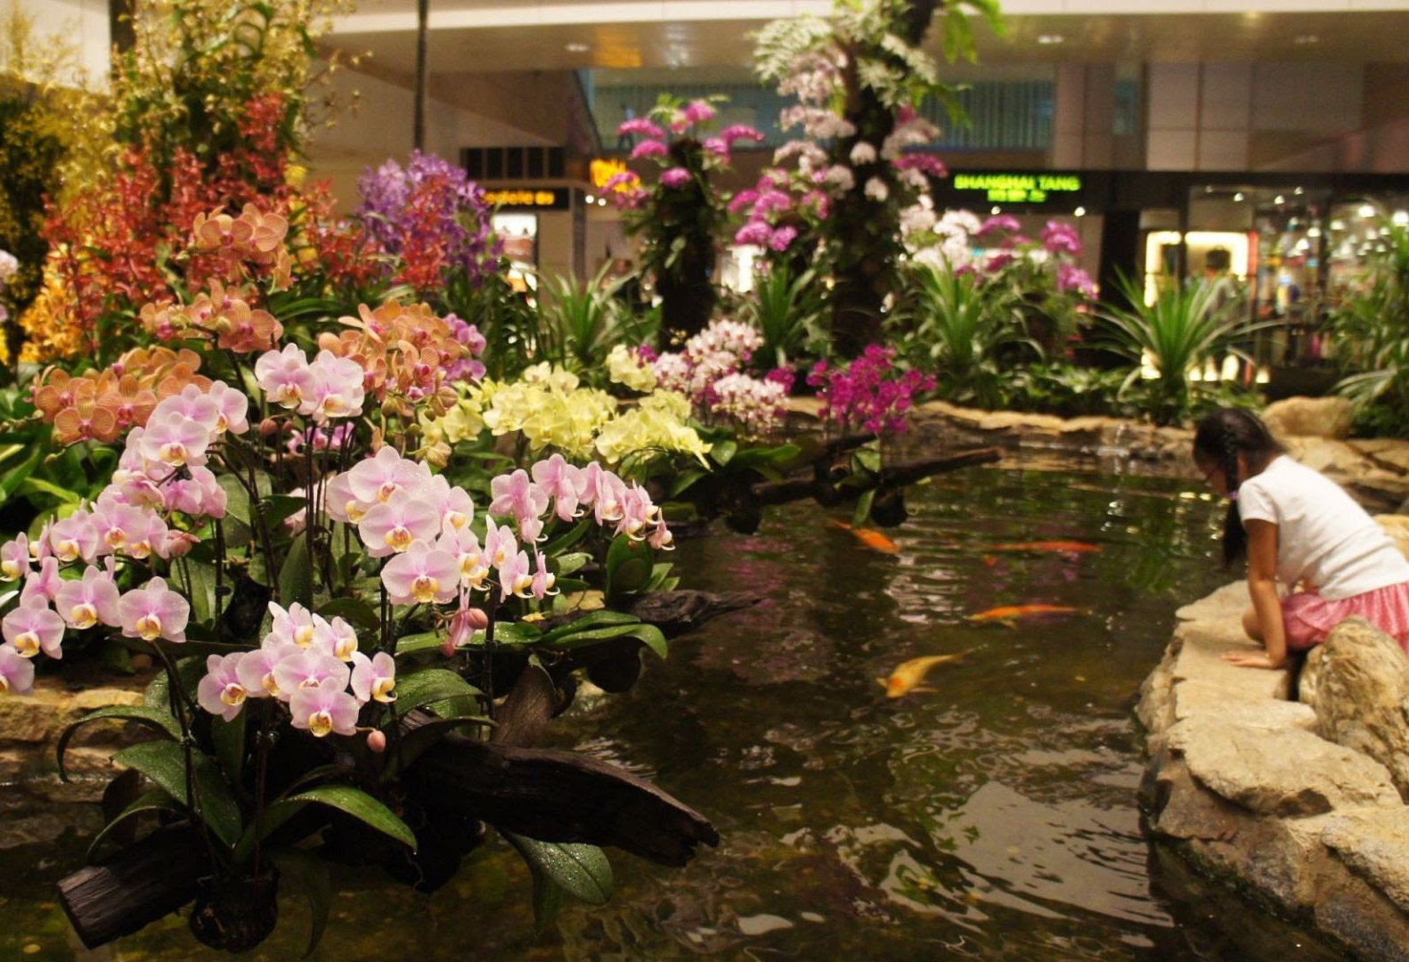
ORCHID GARDEN (T2)
ageschimarche.it
More than 700 orchids of 30 species grouped by their various colors and shapes, representing the 4 elements of nature.

Slide 12
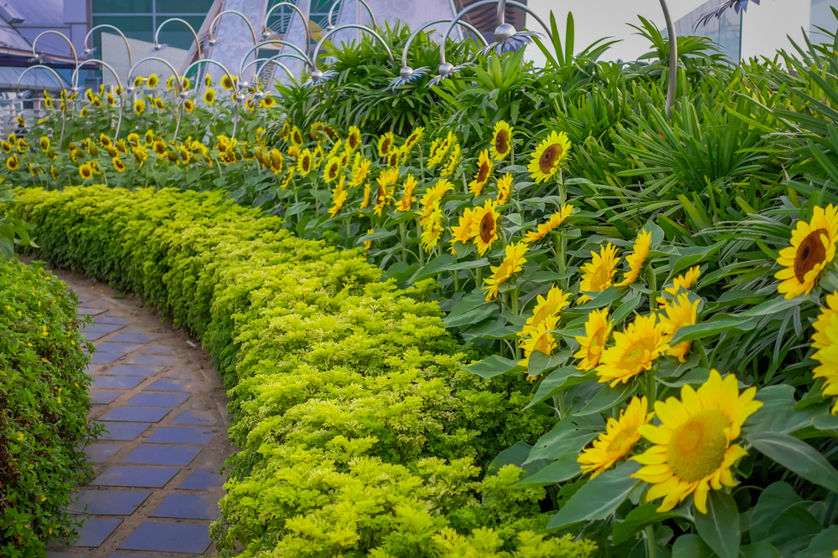
SUNFLOWER GARDEN (T2)
The garden features several varieties of sunflowers grown from their own nursery.

Slide 13
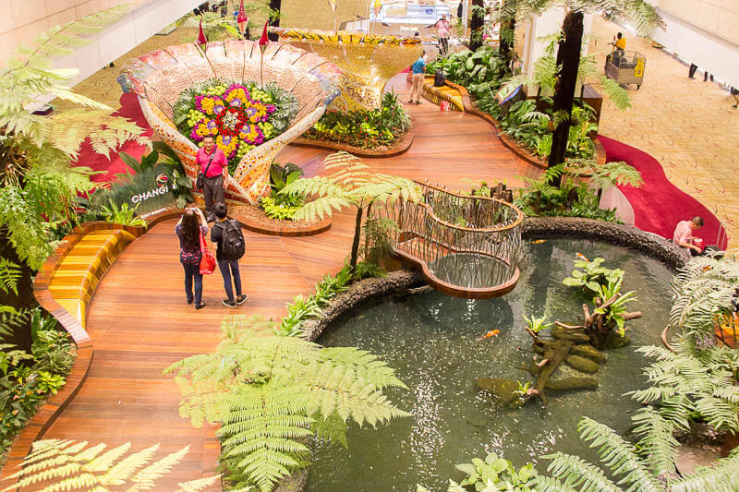
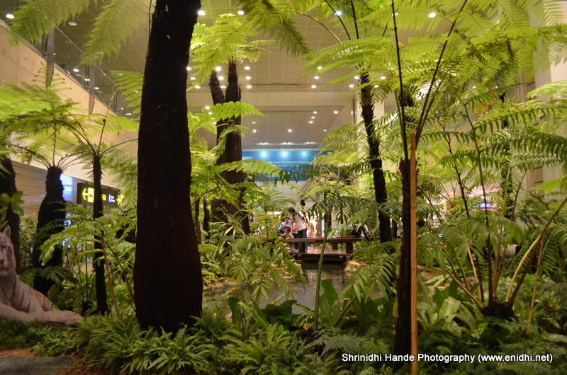
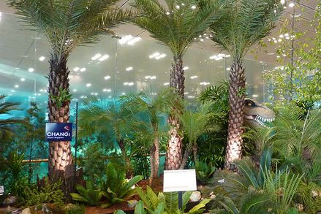
FERN GARDEN (T2)
The garden features
The giant Tasmanian tree ferns - Dicksonia antarctica
Tropical tree ferns from the oldest rainforests in the world
Unique ferns like the Rabbit-foot Fern, Bird’s Nest Fern, Elephant Fern, Fish-tail Fern, and Staghorn Ferns.
www.changiairport.com
www.airfreshener.club
www.airfreshener.club
Giant Tasmanian Tree (Dicksonia Antarctica)

Slide 14
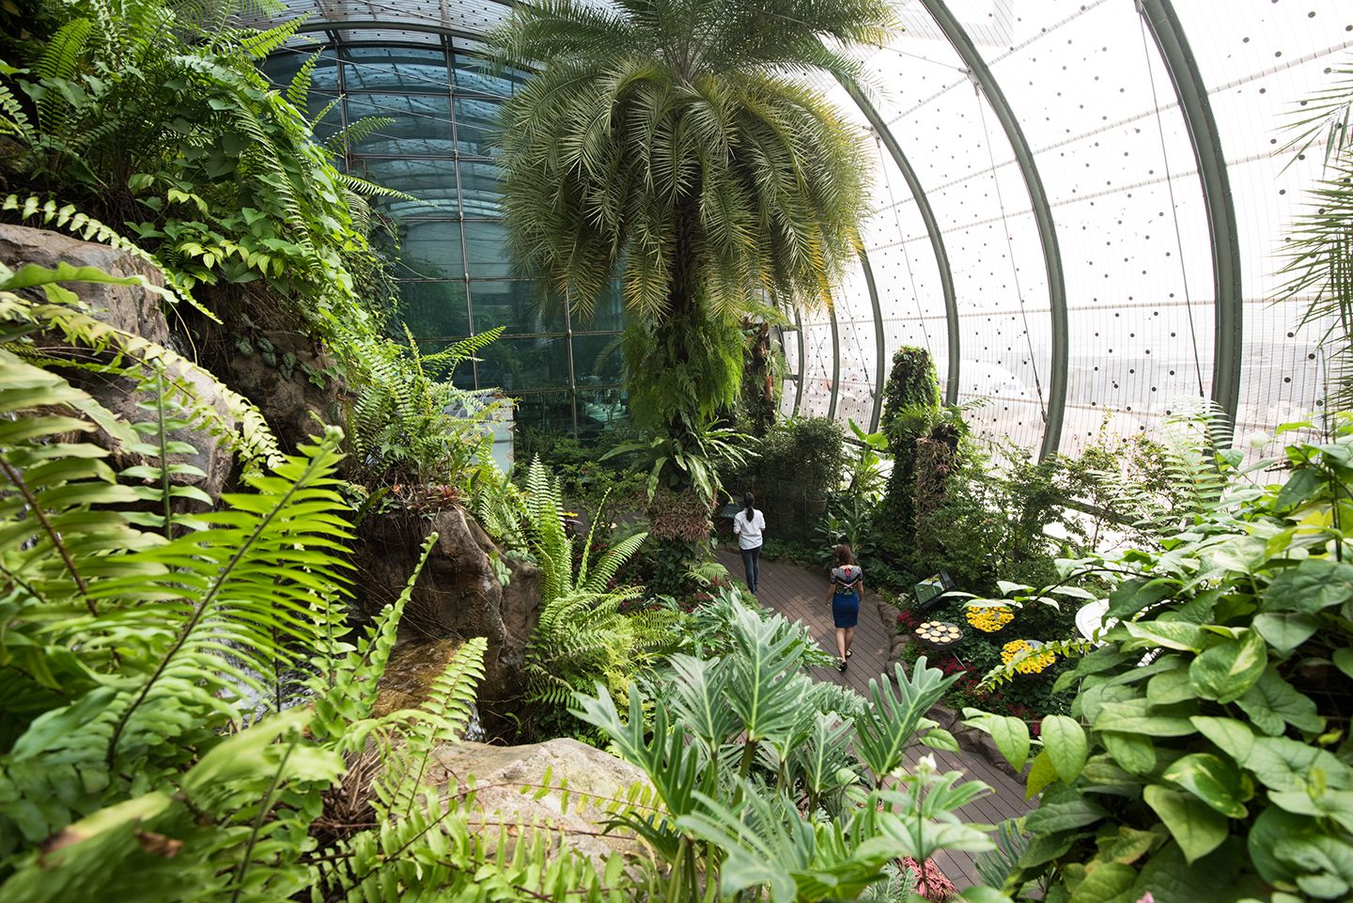
BUTTERFLY GARDEN (T3)
Habitat of 1000 tropical butterfly from 50 species
with a profusion of
flowering plants, lush
greenery and a 6 meter
grotto-waterfall.
changiairport.com
www.nzherald.co.nz

Slide 15
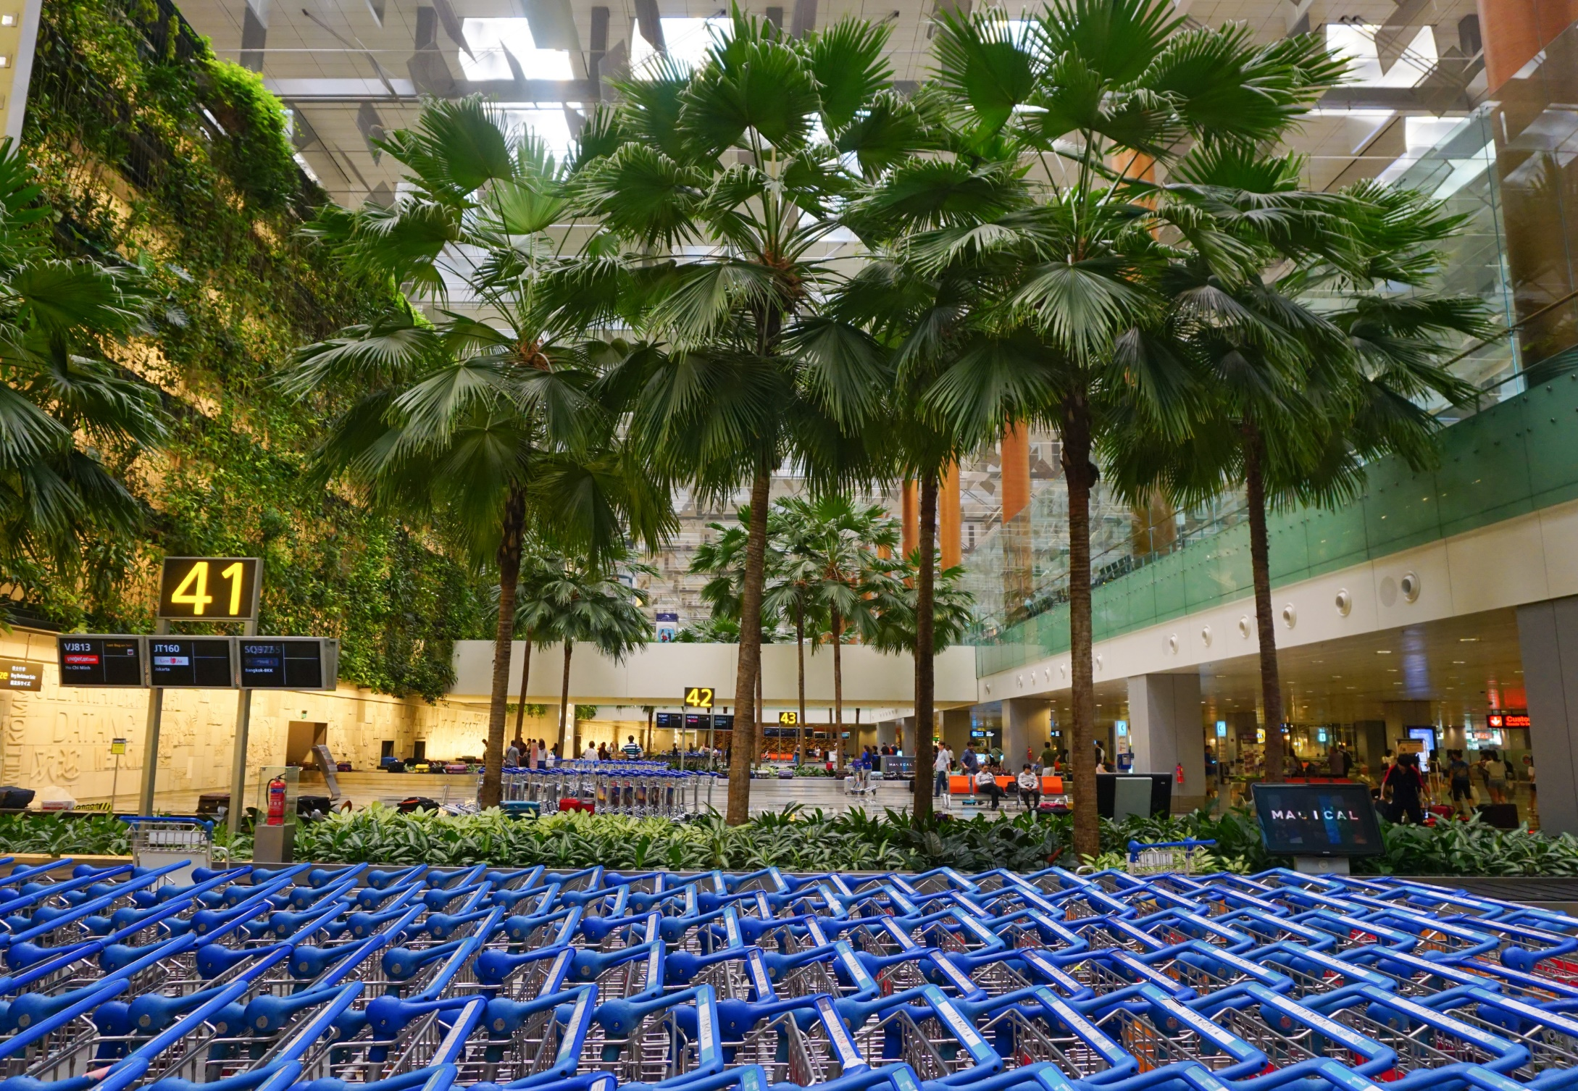
VERTICAL GARDEN (T3)
,
Five storey high vertical garden
Spans 300 metres across the terminal or the length of three football fields
50 species of specially selected plants
Karen

Slide 16
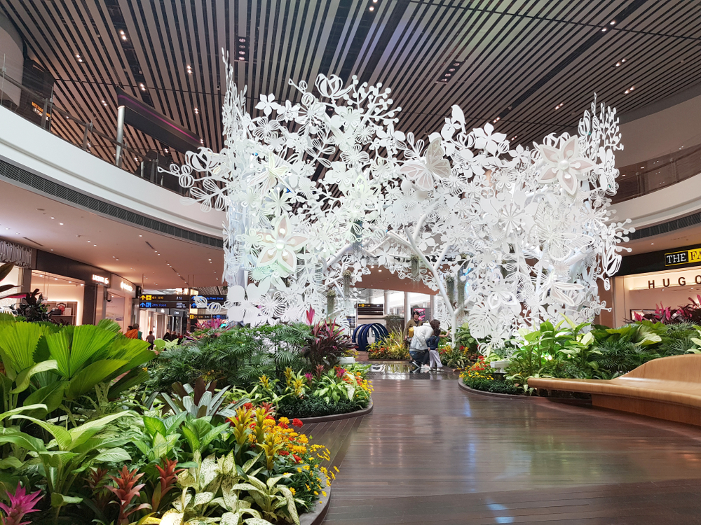
STEEL IN BLOOM (T4)
The garden’s 6m-high centerpiece features intricate botanical motifs modelled in steel.
This structure is juxtaposed with plants that have inspired its design.
shutterstock.com

Slide 17
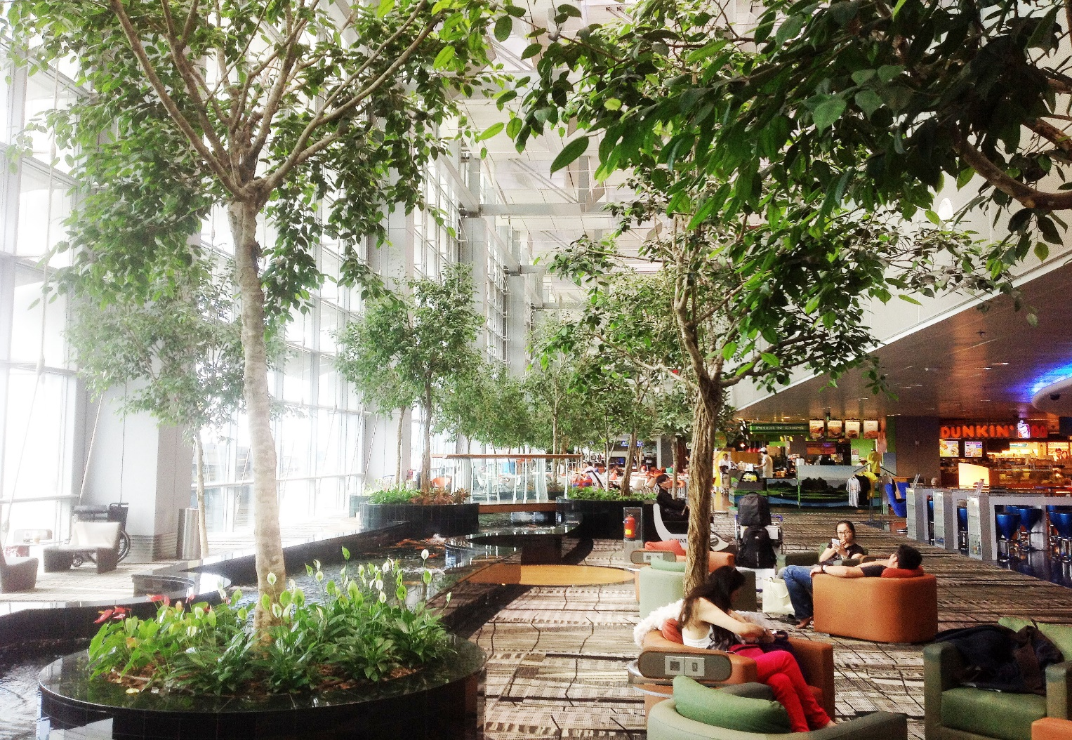
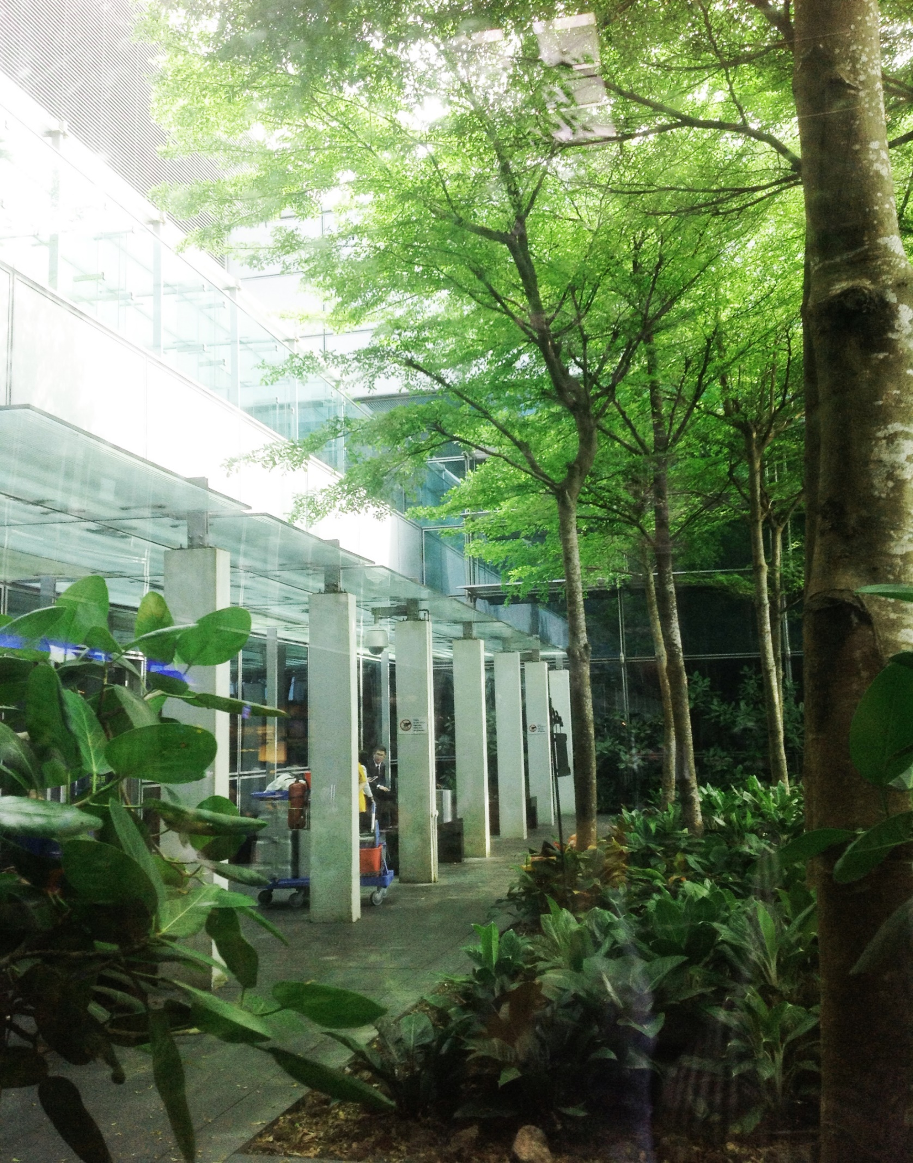
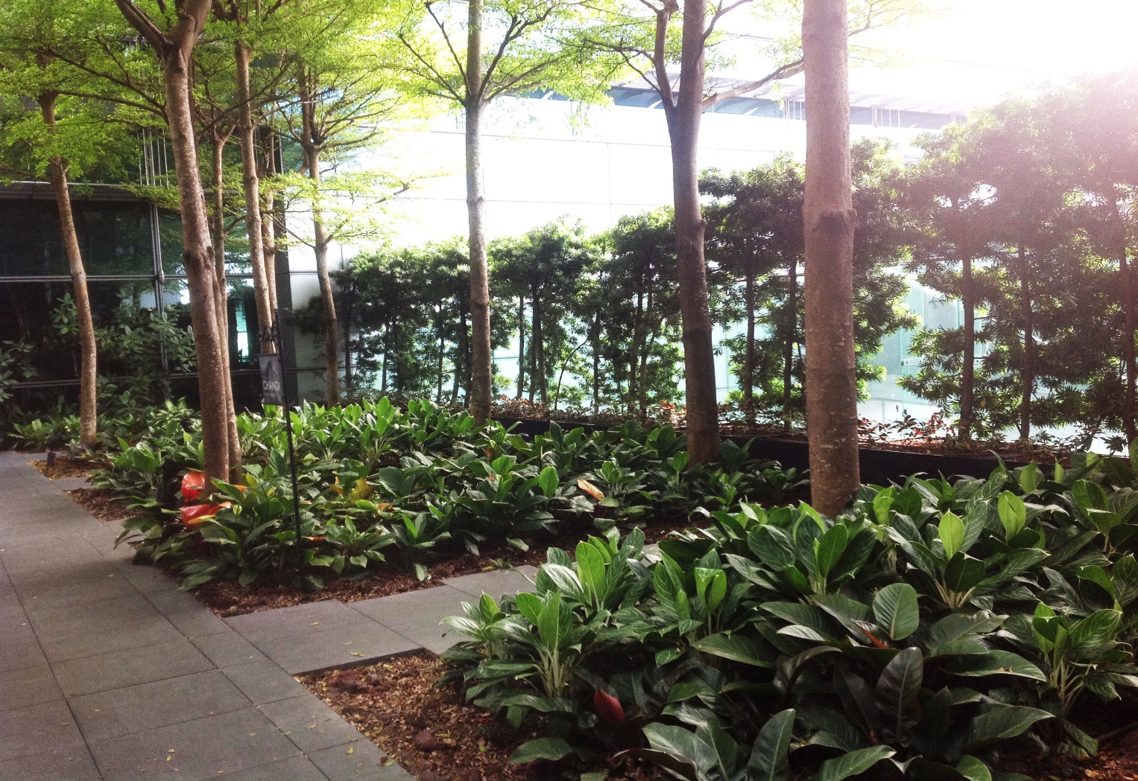
SMOKING AREA
Karen
Karen
Karen

Slide 18
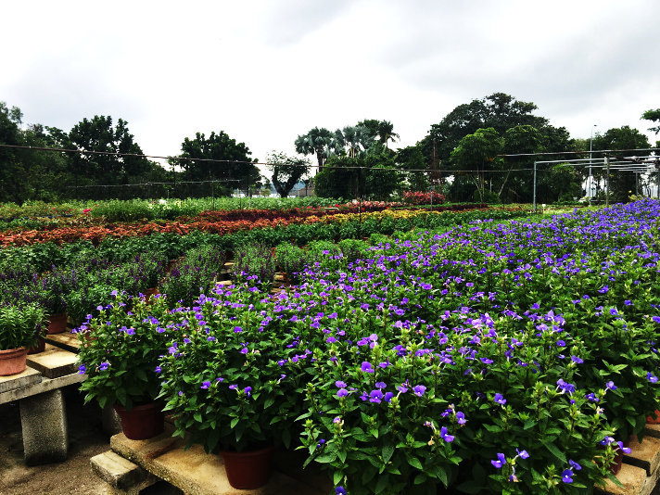
NURSERY
Key challenge in indoor horticulture is the lack of sunlight. As a result, many plants will first have to be acclimatized in the nursery by being placed under a light filtering shade.
Changi Airport Nursery is over 3 hectares, located 25 minutes from airport
500,000 live plants, and 250 plant species
It produces about 3,000 plants a month
With team of 11 horticulturalists, and outsources the landscaping work to external contractors and vendors, who employ about 120 for the task.
(Steve Mollman, 2015)
marinebiologistswithswag.wordpress.com

Slide 19
Thank You

