Slide 2




Contents
The Journey Begins
Last 8 Months
Next 3 Months
Next 12 Months
Next 3 Years
Financial Support
Global Digital Partnership: Earth Ledger

Slide 3

Last 8 Months
September 2018
December 2018
February 2019
April 2019
1.
AIPH 2018 Annual Congress (Padova)
20 - 25 September 2018: Agreed to realign event to 2022

Slide 4
Last 8 Months
September 2018
December 2018
February 2019
April 2019
1.
AIPH 2018 Annual Congress (Padova)
Financial Commitment State Treasure
20 - 25 September 2018: Agreed to realign event to 2022
2.
14 October 2018

Slide 5
Last 8 Months
September 2018
December 2018
February 2019
April 2019
1.
AIPH 2018 Annual Congress (Padova)
Financial Commitment State Treasure
Internal Stakeholder Consultation
20 - 25 September 2018: Agreed to realign event to 2022
2.
14 October 2018
January 2019 - May 2019
3.

Slide 6
Last 8 Months
September 2018
December 2018
February 2019
April 2019
1.
AIPH 2018 Annual Congress (Padova)
Financial Commitment State Treasure
Internal Stakeholder Consultation
Validation - Australis Business Model
20 - 25 September 2018: Agreed to realign event to 2022
2.
14 October 2018
January 2019 - May 2019
3.
4.
February 2019 - May 2019

Slide 7
Last 8 Months
September 2018
December 2018
February 2019
April 2019
1.
AIPH 2018 Annual Congress (Padova)
Financial Commitment State Treasure
Internal Stakeholder Consultation
Validation - Australis Business Model
Global Investment Partner
20 - 25 September 2018: Agreed to realign event to 2022
2.
14 October 2018
January 2019 - May 2019
3.
4.
February 2019 - May 2019
October 2018 - April 2019: Confirmed
5.

Slide 8
Last 8 Months
September 2018
December 2018
February 2019
April 2019
1.
AIPH 2018 Annual Congress (Padova)
Financial Commitment State Treasure
Internal Stakeholder Consultation
Validation - Australis Business Model
Global Investment Partner
Global Digital Alliance Partner: Earth Ledger
20 - 25 September 2018: Agreed to realign event to 2022
2.
14 October 2018
January 2019 - May 2019
3.
4.
February 2019 - May 2019
October 2018 - April 2019: Confirmed
5.
January 2019 - April 2019
6.

Slide 9
Last 8 Months
September 2018
December 2018
February 2019
April 2019
1.
AIPH 2018 Annual Congress (Padova)
Financial Commitment State Treasure
Internal Stakeholder Consultation
Validation - Australis Business Model
Global Investment Partner
Global Digital Alliance Partner: Earth Ledger
NSW State Government Elections
20 - 25 September 2018: Agreed to realign event to 2022
2.
14 October 2018
January 2019 - May 2019
3.
4.
February 2019 - May 2019
October 2018 - April 2019: Confirmed
5.
January 2019 - April 2019
6.
23rd March 2019: Existiing NLP Re-elected
7.

Slide 10

Next 3 Months
April 2019
May 2019
June 2019
1. Spring Meeting
1-5 April 2019

Slide 11
Next 3 Months
April 2019
May 2019
June 2019
1. Spring Meeting
1-5 April 2019
2.
Eden International Workshops
14-18 April 2019

Slide 12
Next 3 Months
April 2019
May 2019
June 2019
1. Spring Meeting
1-5 April 2019
2.
Eden International Workshops
Negotiations with State Government
14-18 April 2019
3.
May 2019

Slide 13
Next 3 Months
April 2019
May 2019
June 2019
1. Spring Meeting
1-5 April 2019
2.
Eden International Workshops
Negotiations with State Government
Federal Government Elections
14-18 April 2019
3.
May 2019
4.
10th May 2019

Slide 14
Next 3 Months
April 2019
May 2019
June 2019
1. Spring Meeting
1-5 April 2019
2.
Eden International Workshops
Negotiations with State Government
Federal Government Elections
State Government Budget Handed Down
14-18 April 2019
3.
May 2019
4.
10th May 2019
10th June 2019
5.

Slide 15

Next 12 Months
July 2019
October 2019
March 2020
June 2020
1.
Finalise Event & Venue Brief
July - August 2019

Slide 16
Next 12 Months
July 2019
October 2019
March 2020
June 2020
1.
Finalise Event & Venue Brief
Planning & Environment Input
July - August 2019
2.
July - August 2019

Slide 17
Next 12 Months
July 2019
October 2019
March 2020
June 2020
1.
Finalise Event & Venue Brief
Planning & Environment Input
July - August 2019
2.
July - August 2019
3.
AIPH National Congress
September 2019

Slide 18
Next 12 Months
July 2019
October 2019
March 2020
June 2020
1.
Finalise Event & Venue Brief
Planning & Environment Input
July - August 2019
2.
July - August 2019
3.
AIPH National Congress
September 2019
4.
Formal Invitation to Other Nations
September 2019

Slide 19
Next 12 Months
July 2019
October 2019
March 2020
June 2020
1.
Finalise Event & Venue Brief
Planning & Environment Input
July - August 2019
2.
July - August 2019
3.
AIPH National Congress
September 2019
4.
Formal Invitation to Other Nations
International Design Competition
September 2019
5.
September 2019 - December 2019

Slide 20
Next 12 Months
July 2019
October 2019
March 2020
June 2020
1.
Finalise Event & Venue Brief
Planning & Environment Input
July - August 2019
2.
July - August 2019
3.
AIPH National Congress
September 2019
4.
Formal Invitation to Other Nations
International Design Competition
Event & Venue Design Development
September 2019
5.
September 2019 - December 2019
6.
December 2019 - June 2020

Slide 21
Next 12 Months
July 2019
October 2019
March 2020
June 2020
1.
Finalise Event & Venue Brief
Planning & Environment Input
July - August 2019
2.
July - August 2019
3.
AIPH National Congress
September 2019
4.
Formal Invitation to Other Nations
International Design Competition
Event & Venue Design Development
Prelim Environment & Planning Approval
September 2019
5.
September 2019 - December 2019
6.
December 2019 - June 2020
7.
January 2020 - June 2020

Slide 22
Next 12 Months
July 2019
October 2019
March 2020
June 2020
1.
Finalise Event & Venue Brief
Planning & Environment Input
July - August 2019
2.
July - August 2019
3.
AIPH National Congress
September 2019
4.
Formal Invitation to Other Nations
International Design Competition
Event & Venue Design Development
Prelim Environment & Planning Approval
State Federal Budgets Agreed
September 2019
5.
September 2019 - December 2019
6.
December 2019 - June 2020
7.
January 2020 - June 2020
8.
June 2020

Slide 23

Next 3 Years
Jul 2020 Sep 2020
Feb 2022 Sep 2022
Apr 2023 Jul 2023
1. Early Works Tendered
July 2020 - August 2020

Slide 24
Next 3 Years
Jul 2020 Sep 2020
Feb 2022 Sep 2022
Apr 2023 Jul 2023
1. Early Works Tendered
July 2020 - August 2020
2.
Overall Site & Event Preparation
September 2020 - September 2022

Slide 25
Next 3 Years
Jul 2020 Sep 2020
Feb 2022 Sep 2022
Apr 2023 Jul 2023
1. Early Works Tendered
July 2020 - August 2020
2.
Overall Site & Event Preparation
September 2020 - September 2022
3.
Foreign Nation Build
February 2022 - September 2022

Slide 26
Next 3 Years
Jul 2020 Sep 2020
Feb 2022 Sep 2022
Apr 2023 Jul 2023
1. Early Works Tendered
July 2020 - August 2020
2.
Overall Site & Event Preparation
September 2020 - September 2022
3.
Foreign Nation Build
February 2022 - September 2022
4.
September 2022
Soft Opening

Slide 27
Next 3 Years
Jul 2020 Sep 2020
Feb 2022 Sep 2022
Apr 2023 Jul 2023
1. Early Works Tendered
July 2020 - August 2020
2.
Overall Site & Event Preparation
September 2020 - September 2022
3.
Foreign Nation Build
February 2022 - September 2022
4.
September 2022
Soft Opening
September 2022 - April 2023
5.
Event

Slide 28
Next 3 Years
Jul 2020 Sep 2020
Feb 2022 Sep 2022
Apr 2023 Jul 2023
1. Early Works Tendered
July 2020 - August 2020
2.
Overall Site & Event Preparation
September 2020 - September 2022
3.
Foreign Nation Build
February 2022 - September 2022
4.
September 2022
Soft Opening
September 2022 - April 2023
5.
Event
April 2023 - July 2023
6. Reconfigure

Slide 29





Private Sector Funding
Australis has received support from 5$ Billion Fund which is focused on Sustainability.

Slide 30




Earth Ledger
A Digital Partner to Support Maximizing Australis’ Global Impact

Slide 31




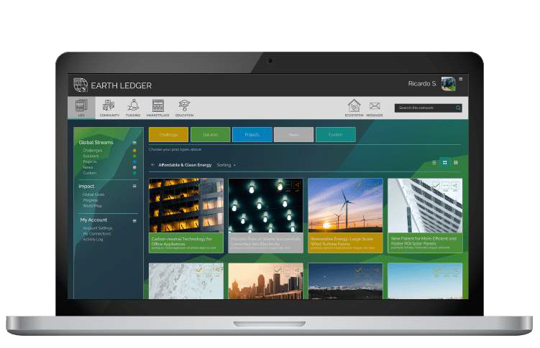






A Global Log of Environmental Challenges and Solutions
Global Log
Funding
Autonomous Community
Education
Marketplace

Slide 32
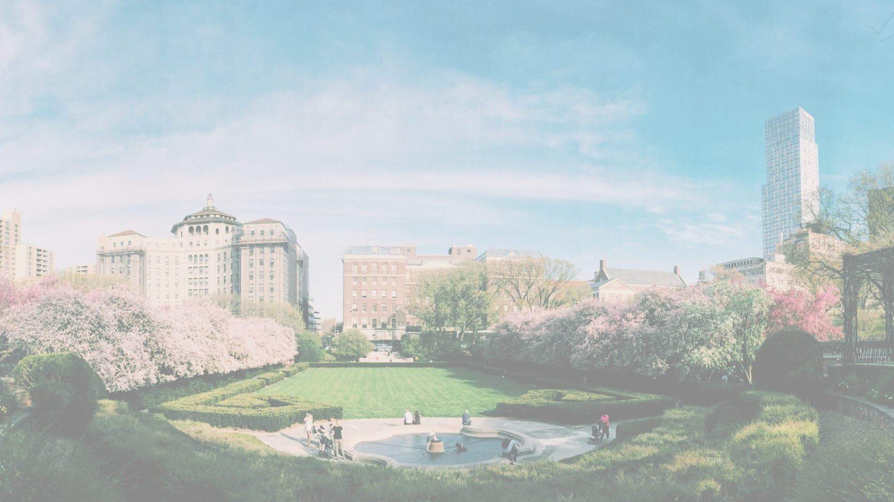





















V
32

Slide 33









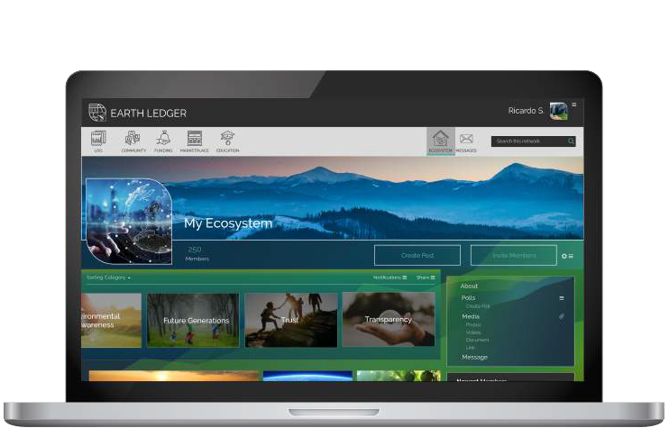


Earth Ledger Network
Consensus
Incentivized
Verified
33

Slide 34
































VISION
Environmental Awareness
Transparency
Restoring Balance to the Environment & Harmony to Our Planet
Sustainability
MISSION
Create an Autonomous Community for
Planet Earth
Trust
Future Generations
CORE VALUES

Slide 35





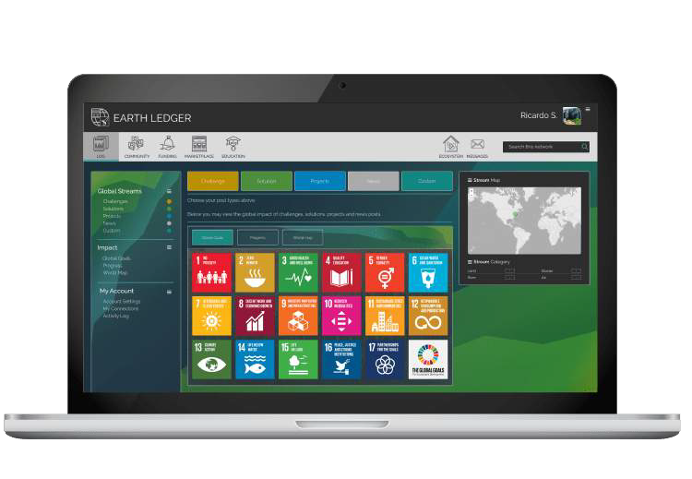

Organize & Mobilize the Restoration of Planet Earth
LOG
FUNDING
COMMUNITY
MARKETPLACE
EDUCATION
Earth Ledger is made up of 5 key components, one of which is a decentralized community that will autonomously resolve the 17 Sustainable Development Goals.

Slide 36



An Autonomous Community
with a Purpose
Earth Ledger is a platform that can support Australis in organizing and mobilizing resources, ideas, teams and attendees.

Slide 37



Provide an Online
Presence and Added Value for Australis
37

Slide 38
Financial Support

