Slide 1
EXPO 2021 DOHA QATAR
BIE Executive Committee Report
INTERNATIONAL HORTICULTURAL EXHIBITION
28th March 2019
Notes:
Dear President, Secretary General,
Distinguished Members of the Executive Committee,
I am honoured to be here, to give you information about the progress in A1 international horticultural exhibition EXPO 2021 Doha, Qatar

Slide 2
Timeline
155 DAYS OF CELEBRATION
CLOSING 17 MARCH
OPENING 14 OCTOBER
2021
2022
Notes:
Expo2021 Doha, Qatar will be open :
on the 14th of October 2021
and will be closed on 17th of March 2022.
The exhibition will last for :
one hundred and fifty five days

Slide 3
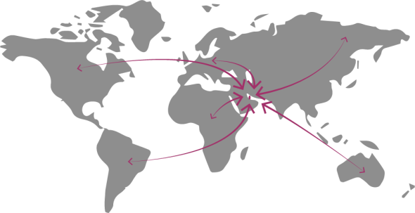
Visitors
3 Million
Visitors
from
12 km distance
80
29 Million passengers
Countries
free access to the Site
Notes:
Expo 2021 Doha. Qatar expected 3 Million Visitors.
Visitors from 80 countries has the privilege of a visa-free entry to Qatar.
And Hamad International Airport in Doha, has an initial annual capacity of 29 million passengers a year.
Also, visitors will be able to enter the exhibition site free of charge.

Slide 4
Themes
Notes:
The Theme of the Exhibition is:
Green Desert, Better Environment.
The Green Desert ideal cannot be reached without integrating the people, gaining social support, realizing cultural change.
Thus, the Green Desert concept entails modern agriculture based on technology and innovation supported by enhanced environmental awareness to achieve the sustainability.
EXPO 2021 Doha, Qatar believes that achieving successful results requires international cooperation around the same goal and key strategic solutions.

Slide 5
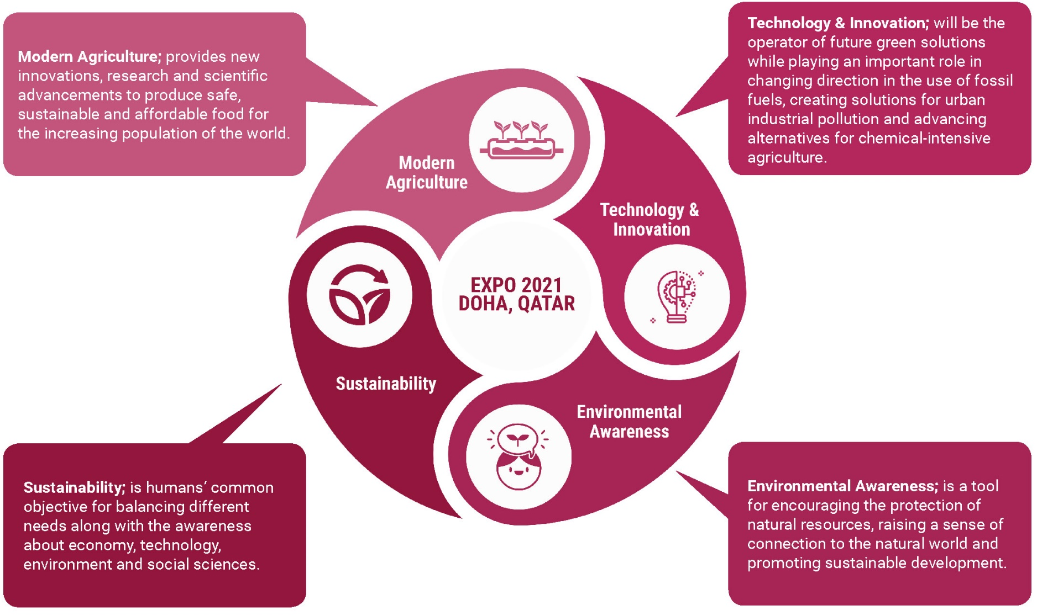
Sub - Themes
Notes:
The theme includes the following 4 topics:
modern agriculture,
technology and innovation,
sustainability and environmental awareness
The four sub themes are in some cases overlapping and intertwining
These sub themes aim to cover as many of modern practices and innovations as possible in the field of horticulture to be showcased during Expo event

Slide 6
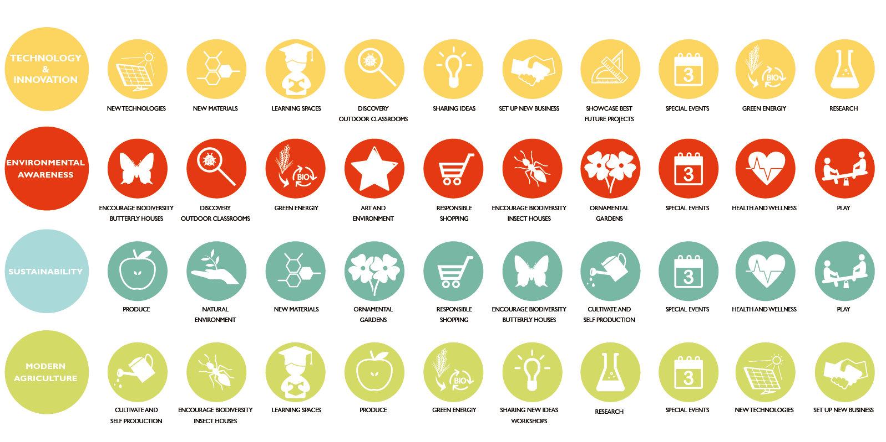
Contents and Programme
Sub-themes application
Notes:
This slide shows the application of the subthemes
This can serve also as a reference guide for the participating countries to help them develop their gardens and themes within the exhibition spaces

Slide 7
Organizational, legal and financial measures and legal states of the organizers
The government of State of Qatar will be the organizer and we will guarantees that all rules and obligation will be fulfilled to organize an international horticultural exhibition in best way
Notes:
The government of State of Qatar will be the organizer,
and we will guarantees that all rules and obligation will be fulfilled to organize an international horticultural exhibition in best way

Slide 8
THE NEW SITE MASTERPLAN
Notes:
since the State of Qatar submitted a new site location to the AIPH and BIE
I would like to show you our new master plan.

Slide 9
Masterplan - New Site for Expo 2021 Proposal
A new site for the Expo 2021 was presented to the AIPH for approval.
AIPH delegation inspected the new site location on Bidda Park in Doha on 19.03.2019.
AIPH approved the site in principle and will give formal approval after the board members meeting and their approval.
Also we present our progress and the new site in BIE executive committee meeting and they been very happy with our change
Notes:
On 19th of March 2019 the new site in Bidda park project was presented to AIPH members during their site inspection.
After visiting the new site we received the initial approval and we are waiting for the formal approval after the board members meeting and their approval.
Also we present our progress and the new site in BIE executive committee meeting and they been very happy with our change

Slide 10
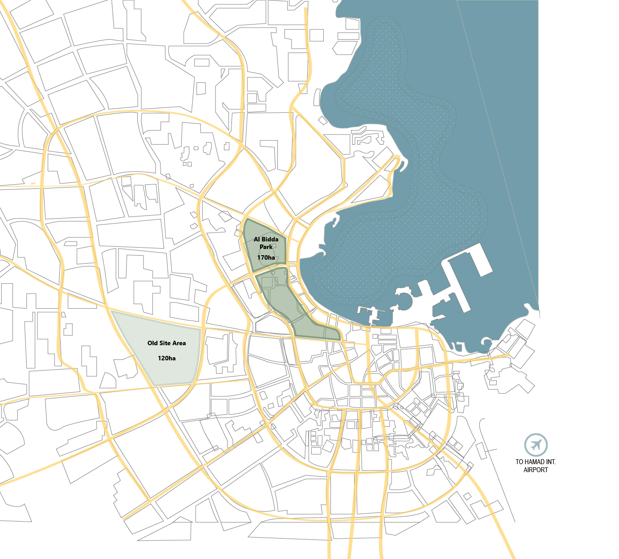
Bidda Park – New Location for Expo 2021
Why Relocate the Site:
Provides for better confidence in terms of construction timeline
Site ready in terms of infrastructure services and landscape
More time to focus on the core EXPO operations activities
Site location and vicinity to main tourist attraction sites – in the heart of the city
Parts of site still under construction – can fit the EXPO event components
Higher profile due to location & available services
Bidda Park Area: 170 ha
Old Site Area = 120 ha
Notes:
The advantages of relocating the Site:
Provides for better confidence in terms of construction timeline
Site ready in terms of infrastructure services and landscape
Parts of site still under construction – can fit the EXPO event components
Higher profile due to location & available services
This allows us to have more time to focus on developing the core EXPO components and operations activities in the unbuilt areas of the park.
The location of Bidda park is the highest profile and value in Doha due to location & available services
The old sit was around 120 ha but the new site is around 170ha
There is more than 5000 underground car parks with cooling system in 5 different location under the new site

Slide 11
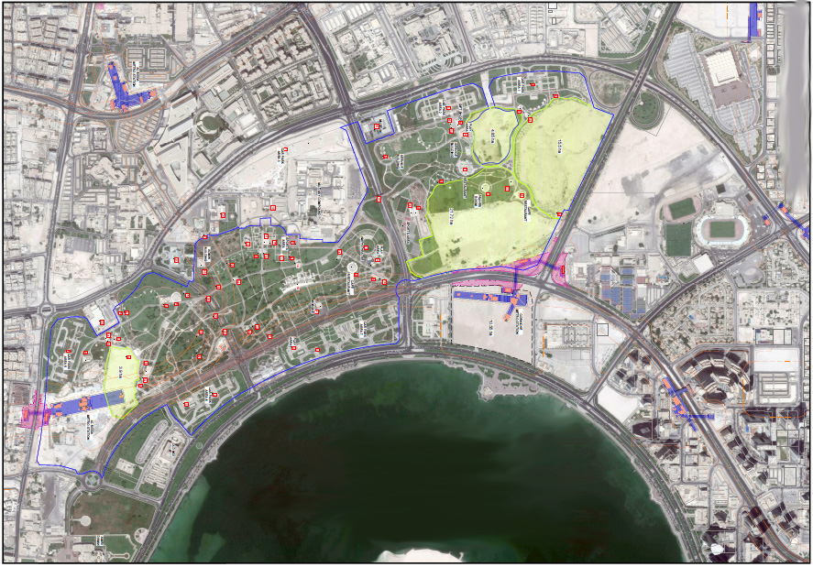
Current Bidda Park Master Plan
Name | No. of Units
Car Park | 6
Play Ground | 7
Outdoor Sports Court | 13
Outdoor GYM Equipment | 6
Café / Restaurant | 9
Restaurant / Shops | 1
Gift Shop | 5
BBQ Area | 7
Admin Building | 1
Amphitheater | 1
Building /Service | 1
Shop ( Bike Rentals ) | 1
Toilets | 11
Museum | 1
Maze Garden | 1
Water Plaza | 1
Bridge | 4
11
Notes:
You can see that the vacant areas are highlighted with yellow
In these areas the Expo components can be implemented respecting the existing park and using it as a base for further development.
As you can see, the main areas of sit on the northern park of the Park, where Corniche metro station is under construction.

Slide 12
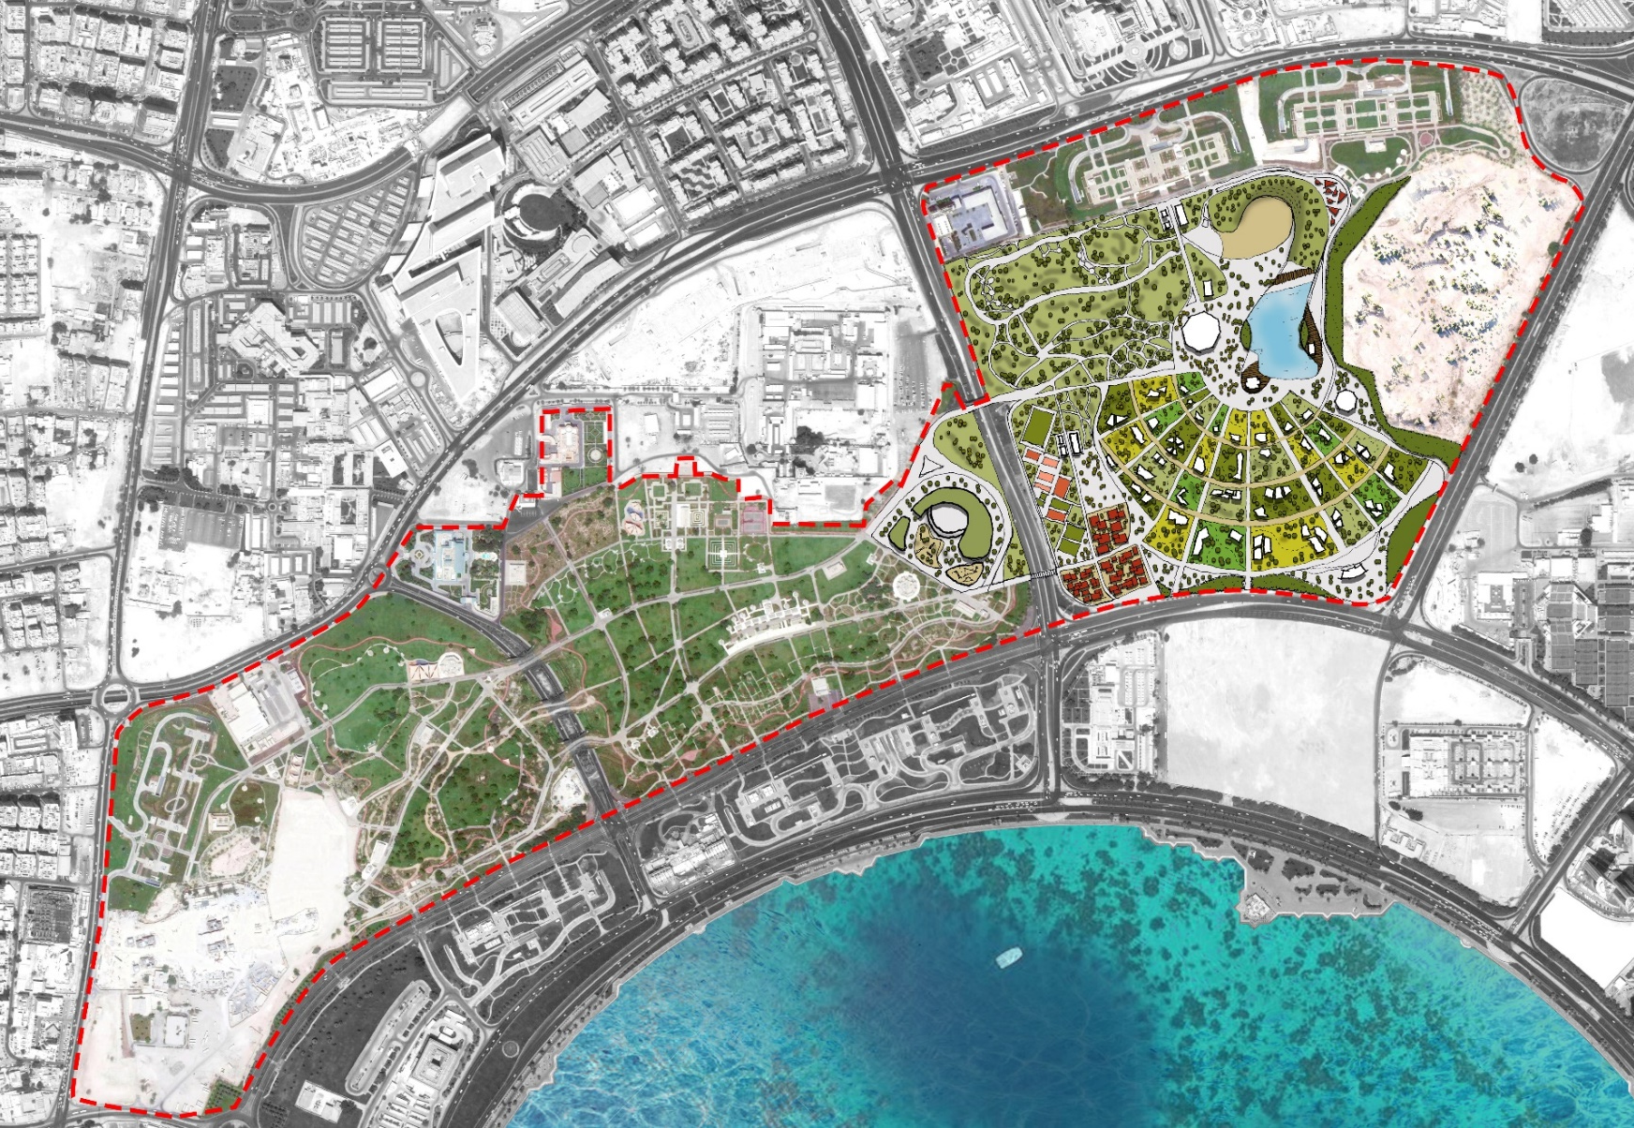
Proposed Bidda Park Master Plan
12
Notes:
This is the proposed masterplan.
As mentioned above, the main areas of Expo Site is located in the northern part of the Park and this is were the Expo components and programs will take place.
In particular the area of the international gardens and expo hill/ expo lake intervention will be developed around the main central area.

Slide 13
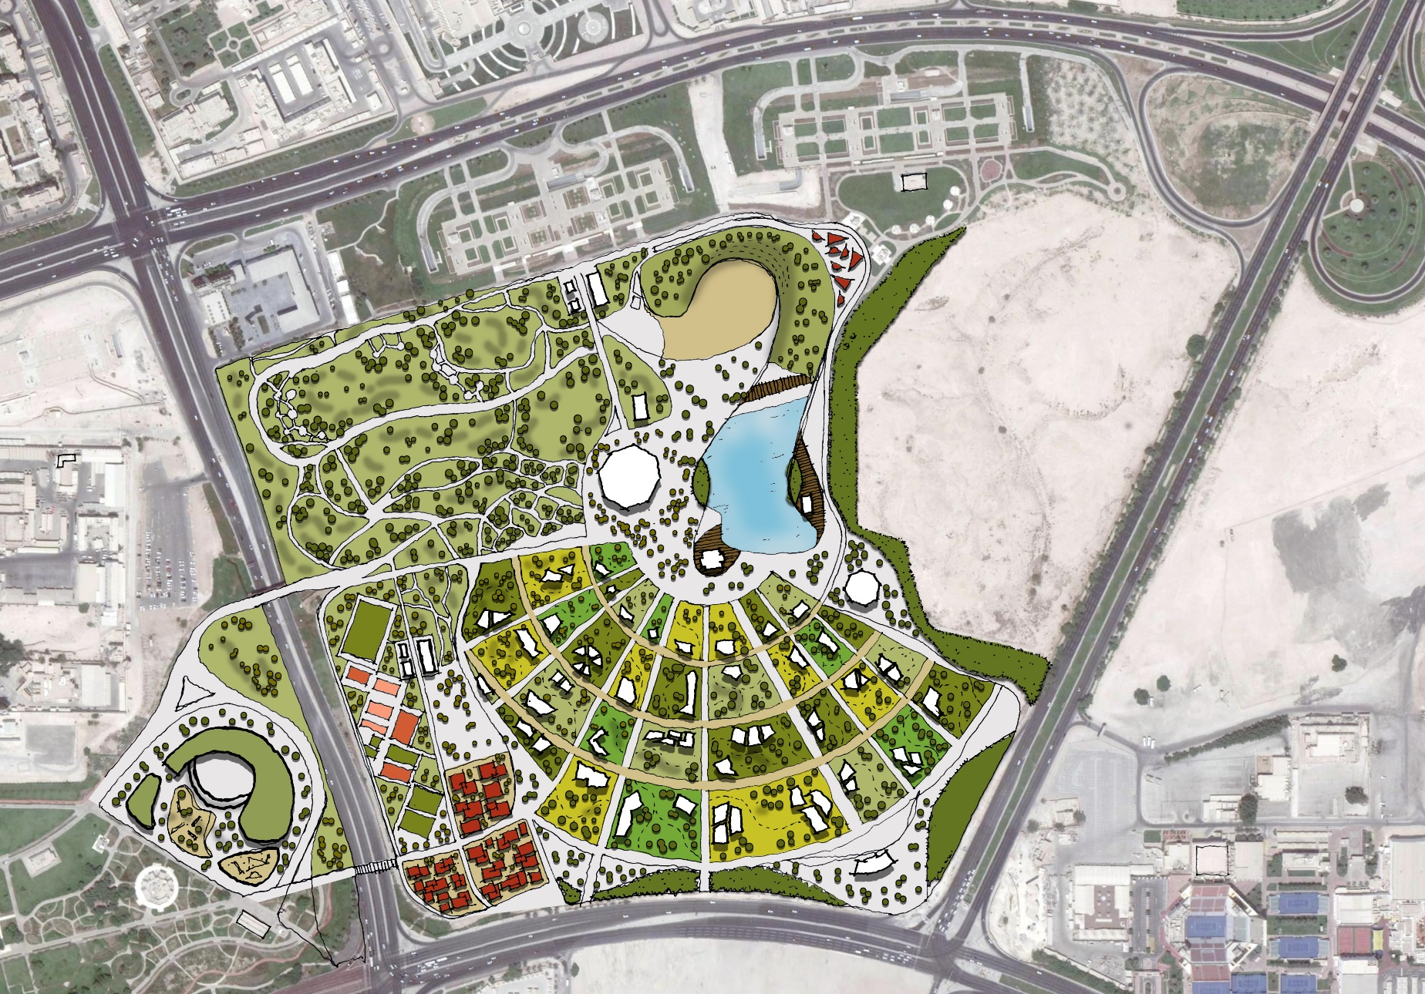
Exhibition Area General Arrangement
Car Parking
Expo Hill
Stage area
Grand Desert Park
Multifunctional Building
Qatari Pavilion
Expo Lake
Expo Square
International Gardens
Sport Hub
Childcare Building
Learning Gardens
Souq
Exhibition Gateway
And Metro Station
Proposed Pedestrian Bridge
N
Notes:
This slide shows a zoom in plan of the main intervention area for the expo project
The general arrangement is developed to includes:
Exhibition Gateway and metro station
One main central axis, connecting the area to the Southern part of the park, connected by a pedestrian bridge. Another pedestrian bridge is proposed to the East near the proposed souq.
Also we will have Expo Hill + Expo Lake + Multifunctional building in the north-western end, Childcare Learning Gardens on the southern end – across the road – and Exhibition Gateway in the north-east end, passing through the international gardens area.
The majority of the existing landscape is maintained in the design, adapted to welcome the new functions where needed.

Slide 14
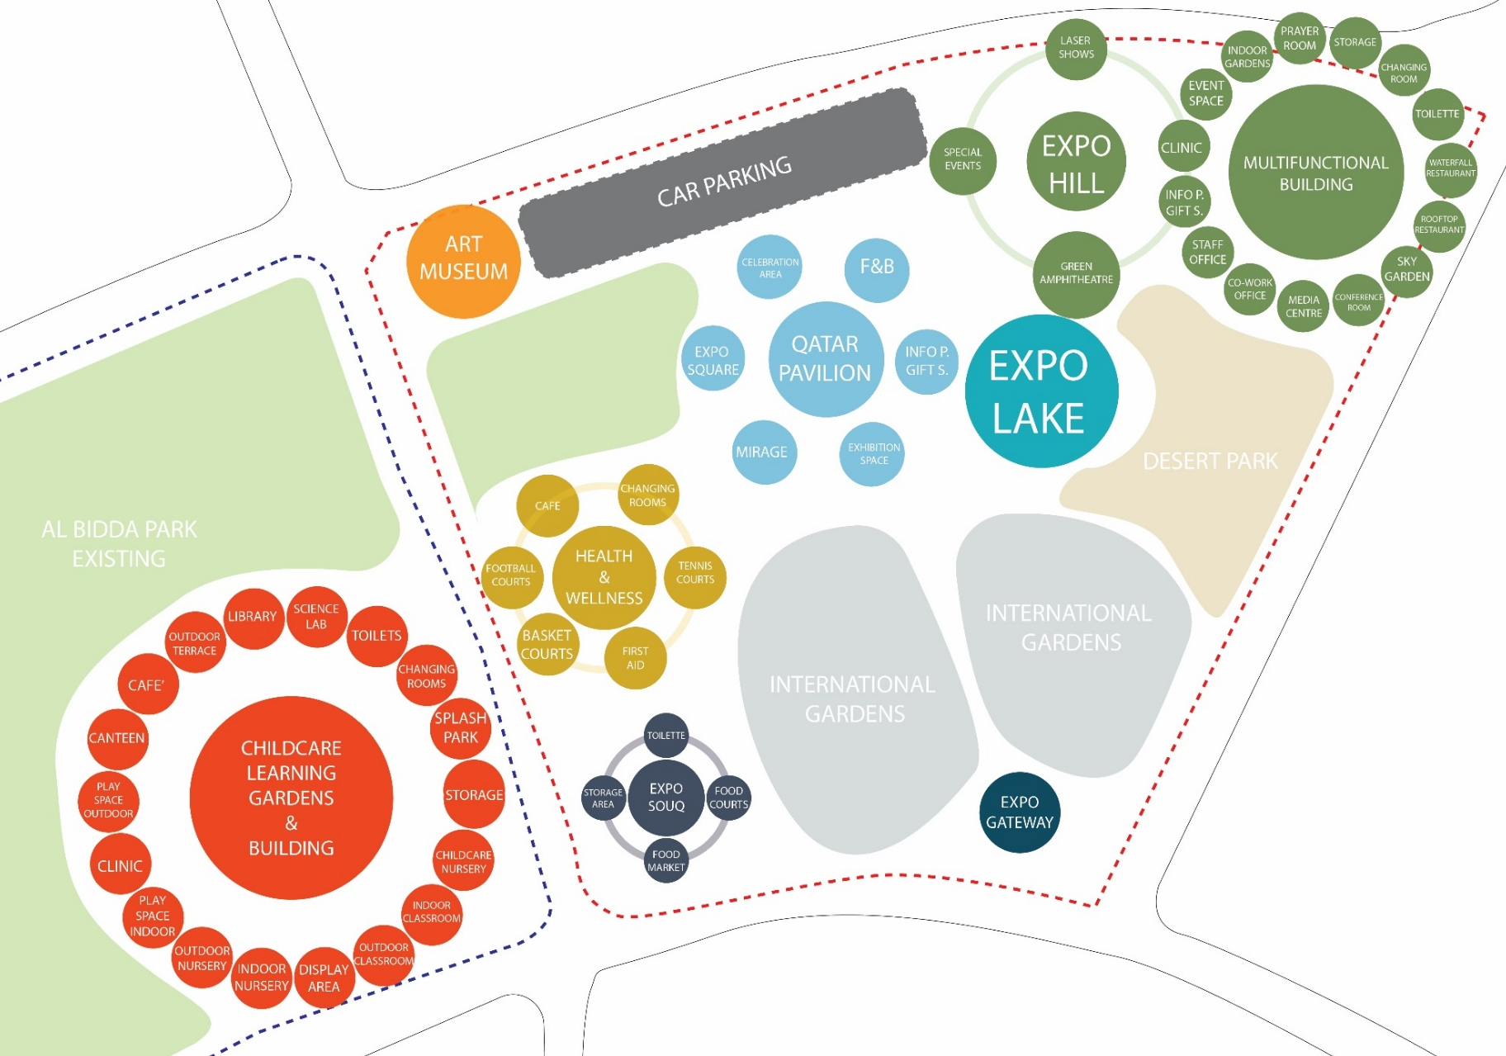
Project Components – Expo 2021
Notes:
This slide shows the expo components taken in consideration during the planning process

Slide 15
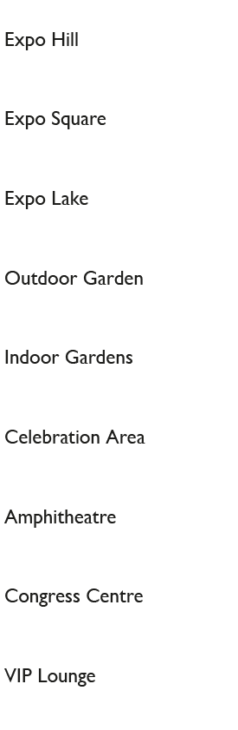
EXPO Site Contents
Main Components
Services and Facilities
Notes:
For sure Expos requirements was taken in consideration during the design and process
Among these, major ones are Expo hill, Expo lake and Expo square, as well as celebration and event areas, indoor and outdoor international gardens.
Beside the main ones, some services and facilities necessary have been identified too, which are shown on the right side of the page such as food court , toilets etc.

Slide 16
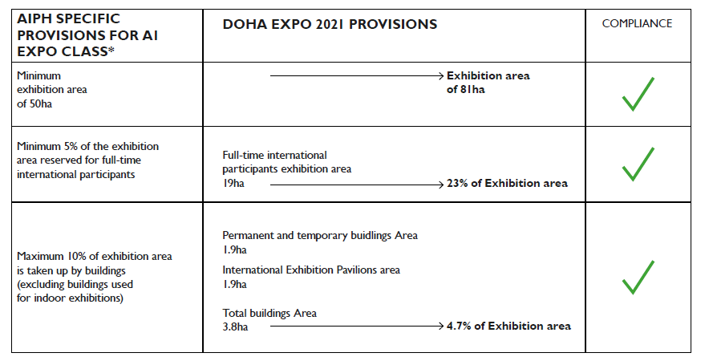
AIPH Requirements
170ha
9%
of Exhibition
Area
15ha
buildings
Maximum 1.5ha
3.4ha
2.5% of
Exhibition Area
Notes:
The Exhibition Site covers an area of 170 ha
15 hectares of the exhibition area will be used for the gardens of international participants

Slide 17
Communication, Marketing and Promotion
In preparation for the promotion and marketing for the Expo 2021, we have involved the Doha 2022 organizing committee to prepare four tenders for the following:
Expo Branding, Logo and website.
Expo Communication
Expo Marketing
Event Operations
These are ready and will be released shortly.
Initial contact with some EU countries representatives has taken place in Doha and we received positive response for participation.
Notes:
In preparation for an big event such as Horticultural Expo, promotion and marketing is very important. This is why we have already started to involve the organizing committee for the preparation of 4 tenders for:
Expo branding, website and develop a new logo
Expo communication
Expo marketing
Expo operations.
We are aiming to call on board these experts soon.
In addition to this, initial contact has been made with representatives of some EU countries who are willing to participate in the event

Slide 18
DOHA EXPO 2021 Legacy
Doha EXPO will provide for a platform to experience modern agriculture technology and environmental awareness
Instill values and lessons learned to develop the EXPO themes and sub-themes through activities which will continue to be implemented in the future
Legacy mode is a testimony on how DOHA EXPO 2021 will be an example to follow in the world .
Notes:
Expo 2021 Doha Qatar will serve as a platform where new technologies and sustainable practises will be developed and presented,
and from which they will be spread worldwide to be promoted and implemented in the future.
Expo will break new ground in terms of modern agriculture technologies and innovations for the greening of the desert which will be an example to follow in the world.

Slide 19
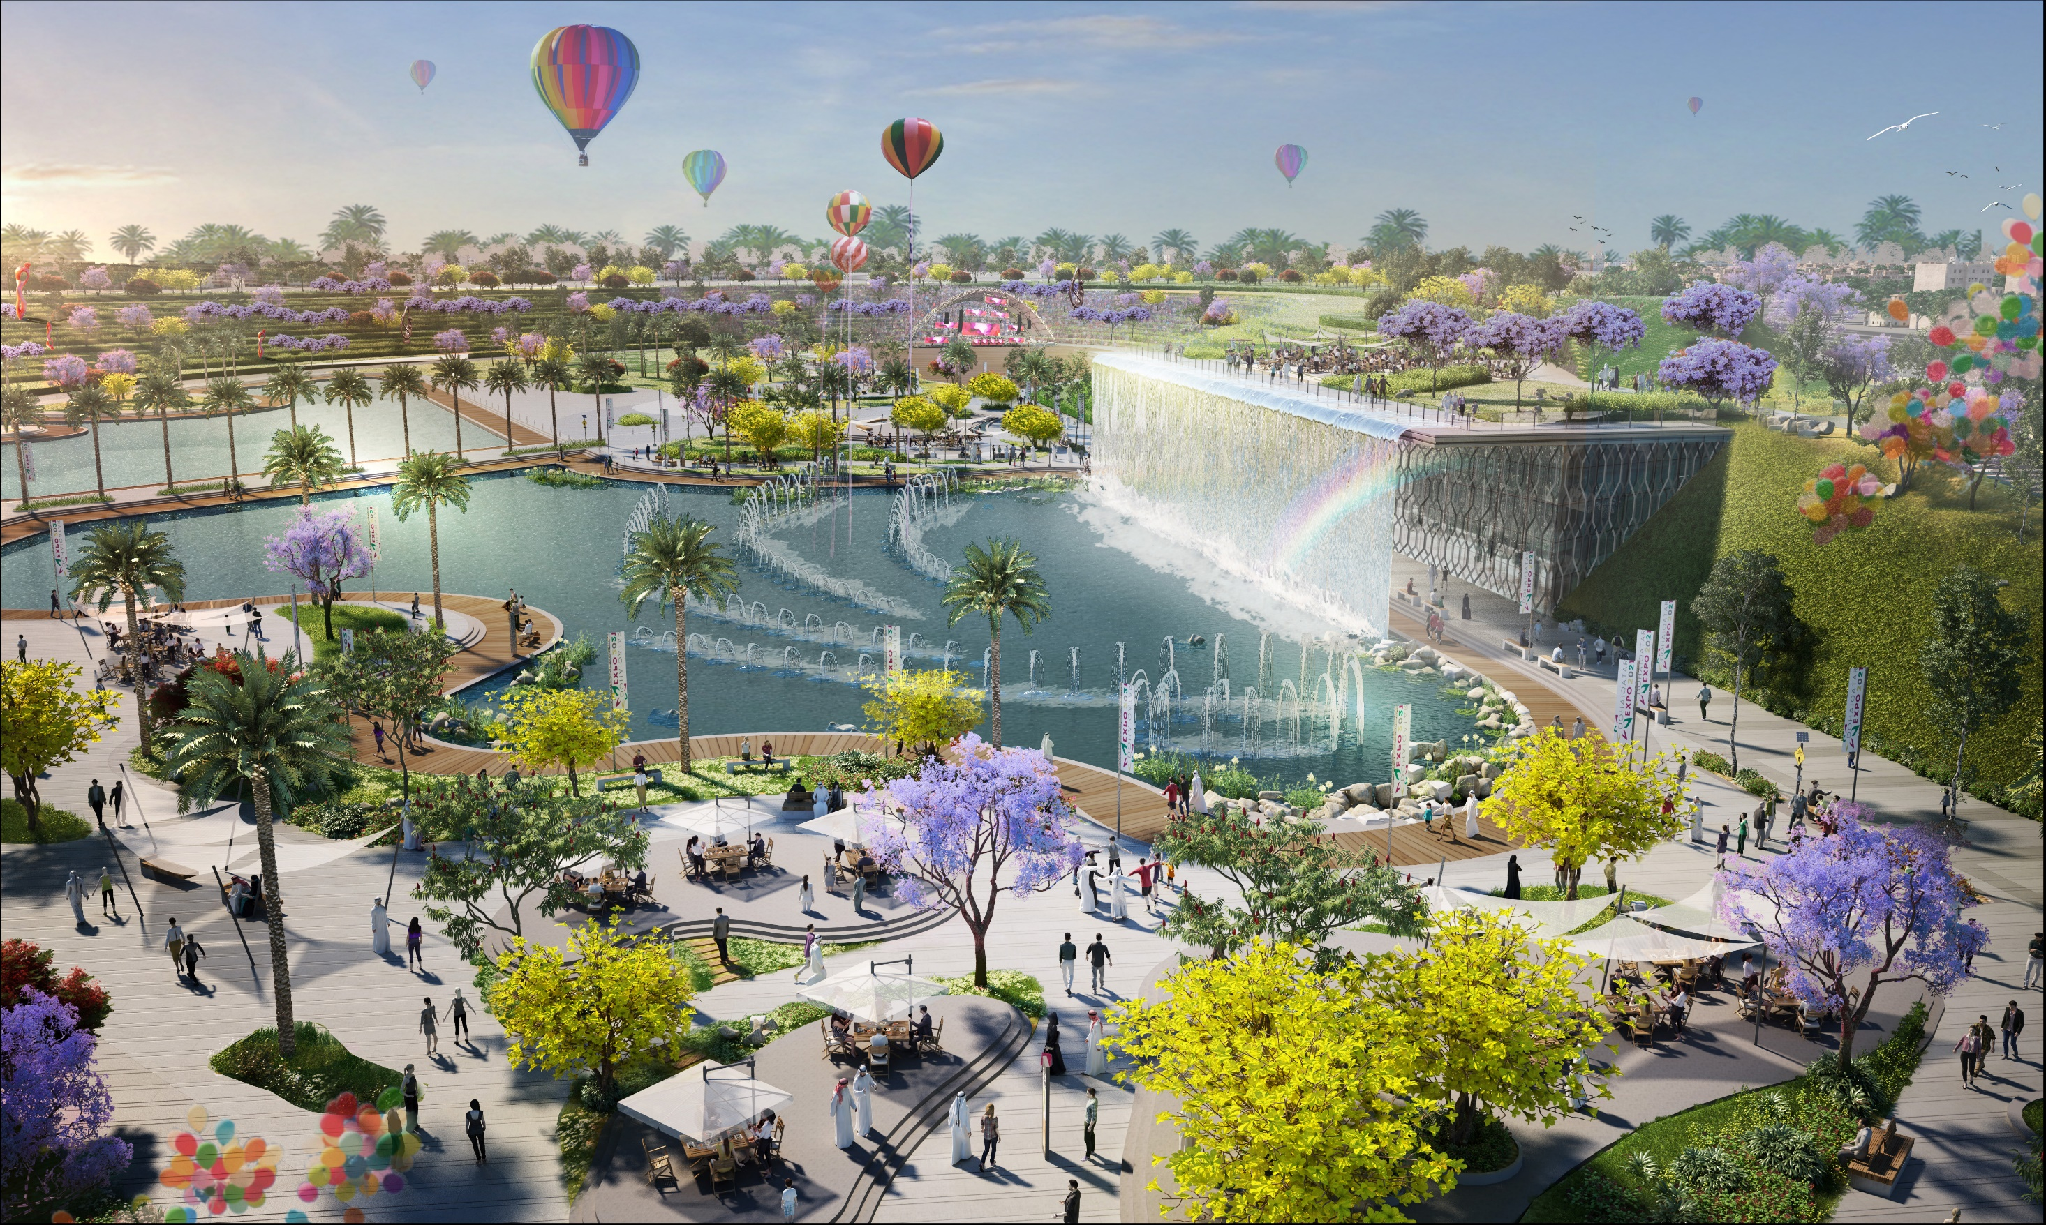
Notes:
This aerial shot looking towards multifunctional building with the cascade on the façade, Expo lake with dancing fountains and Expo hill on the background, where events like the participant national day and concerts will take place.

Slide 20
THANK YOU
Notes:
And now I would like to show you a video about the new site
thank you for your attention.

