Slide 1
Effective Intellectual Property Protection for Plant Innovations
The key to a consistent flow of new Plant Varieties in China
By Dr Edgar Krieger | CIOPORA
The World Ornamental Horticulture Summit
September 12, 2019 | Beijing, CHINA

Slide 2
Agenda
CIOPORA
Who we are and what we do
IP Protection for Plants
Why protect Intellectual Property and plant innovations in particular?
Horticultural hub China and its PVR System
An overview of China’s progress in horticulture and Plant Variety Protection
China PVR – Breeders perspective

Slide 3
CIOPORA: Who We Are
International Community of Breeders of Asexually Reproduced Horticultural Varieties
CIOPORA MEMBERSHIP
REPRESENTATION
Breeders of asexually reproduced horticultural varieties holding 2/3 of world’s PBR titles
Further to direct members, represents 200 breeders worldwide
The majority:
small and medium-sized
breeding companies
FOUNDED
1961
simultaneously with the establishment of UPOV
116
Members
SPECIALIZES IN
24
Countries
IP protection of asexually reproduced horticultural varieties
5
Continents

Slide 4
CIOPORA Breeder Members

Slide 5
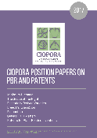
CIOPORA: What We Do
REPRESENTATION
IP ADVOCACY
MONITORING
COMMUNICATION
EDUCATION
Represents plant breeders, promotes and lobbies for their interests before governments
Works on strengthening the systems of IP protection for plants worldwide
Monitors global developments in IP for plants, biotechnology and biodiversity
Compiles positions on IP and informs its members about global developments
Educates all actors of the horticultural value chain on IP via the CIOPORA ACADEMY program
Observer at UPOV, the Administrative Council of CPVO
Advocates before MARA, NFGA, the EU Commission, USPTO, USDA, etc.
Oct 20 - 21 – CIOPORA Academy Madrid
Nov 4 - 5 – CIOPORA Academy Amsterdam

Slide 6
China & CIOPORA: A Decade of Good Cooperation
5
Sept 11, 2019
New mission to China
Meeting with MARA and NFGA
Event
The representatives of MARA, NFGA and the People’s Supreme Court participate in the CIOPORA AGM in South Africa
April 2019
Input to Draft Law
March 2019
CIOPORA submits comments to the draft PBR Regulation
Bilateral meeting
CIOPORA Mission to China. Meetings with
MARA, NFGA, the People’s Supreme Court, and CANPV
2018
Permanent advocacy for improvement of the PBR law
Event
2006
CIOPORA AGM in Beijing and Asia PBR Conference

Slide 7
Why Protect Intellectual Property?
MORAL OBLIGATION
Article 27 (2) of the Universal Declaration of Human Rights: “Everyone has the right to the protection of the moral and material interests resulting from any scientific, literary or artistic production of which he is the author.”
INCENTIVE & REWARD FOR INNOVATION
TRIPS AGREEMENT
The core idea of the TRIPs Agreement is that industrialized countries open their markets for products from developing and newly industrialized countries and, in return, the latter provide for effective IP protection.
Society benefits from the results of innovation
IP Protection provides an incentive to inventors and grants a reward for their activity and its results.
IP

Slide 8
Why Protect Plant Innovations?
BENEFITS THE ENTIRE VALUE CHAIN
TIME & COST CONSUMING
Innovative plant varieties with improved traits help increase profits across the entire horticultural value chain
Development of plant novelties require considerable investments by breeders:
New rose variety ≈ 5 years
New apple variety ≈ 20 years
PLANT
BREEDING
BENEFITS THE SOCIETY
RESULTS CAN BE EASILY PROPAGATED
Society as the end-consumer of plant products benefits from the plants’ environmental, aesthetic and nutritional qualities
The ease with which the asexually reproduced ornamentals & fruits can be propagated makes such varieties especially vulnerable to unauthorized production

Slide 9
China‘s Horticulture is Growing
China flowers & ornamentals, 2010 – 2016¹:
Ornamentals production Area, 2016
Cut roses, production area in ha³:
+27%
+90%
+120%
15,730 ha
Production area
Production value
Export value
CHINA
Ecuador
5,497
170,397 ha
EUR 6.5 bn
EUR 95 mio
Kenya
2,164
Colombia
1,731
CASE: KIFA, A major floriculture hub²:
2,348
Mexico
The farmland of KIFA registered producers exceeds 2,600 ha in 2017
Their output value per ha is estimated at ¥ 450,000 / € 58,286
ha
Carnations, production area in ha³:
Dounan, Kunming:
Kunming International Flora Auction Trading Center (KIFA)
4,031 ha
CHINA
Colombia
933
Turkey
¥
482
Italy
722
466
Mexico
1 & 3 – AIPH/Union Fleurs Statistical Yearbook 2017; 2 – Hortiflorexpo IPM Shanghai, http://en.hfexpo.org/news/34, 21.08.2018.

Slide 10
Things that Matter: Growers’ Income
“Earnings per ha in ornamentals and fruits are up to 100 times higher compared to agricultural crops.”
Source: FAO, CIOPORA

Slide 11
Solutions Required to Increase the Flow of New Varieties in China
Perspective of ornamental and fruit breeders

Slide 12
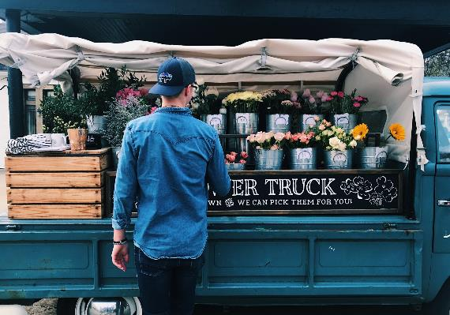
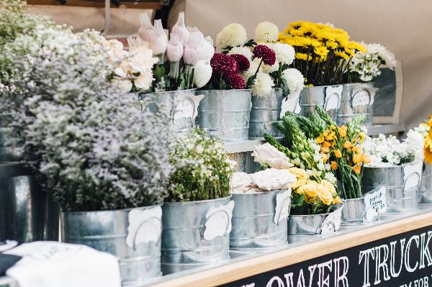
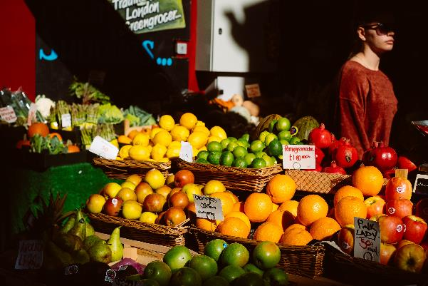
Ornamentals and Fruits: Crop-Specific Solutions Needed
Ornamentals & fruits are not subsistence crops, but business crops
Flowers and fruits are intended for the end-consumer in domestic or foreign markets
Most valuable parts of these varieties are flowers and fruits, not the seeds or plants/trees
Katy Belcher, Cam Morin, Clem Onojeghuo, Unsplash.com

Slide 13
Increase Awareness!
In order to be able to comply with rules, one must know and understand them.
Plant Breeders´ Rights system in China is rather young (20+ years) and the users of the system are many.
Increased awareness about the existence of Intellectual Property Protection for plant innovations and the system’s value for the industry and society is needed.
Raise awareness
towards
Plant Breeders‘
Rights
Loverna Journey, Unsplash.com

Slide 14
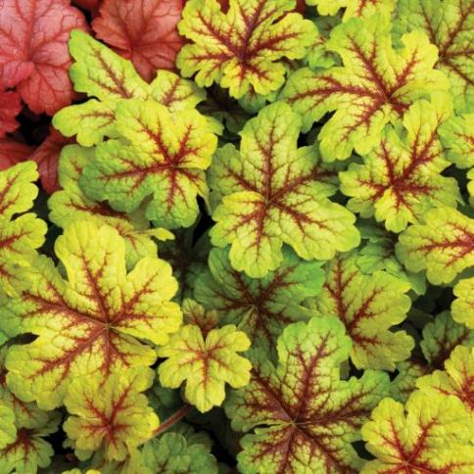
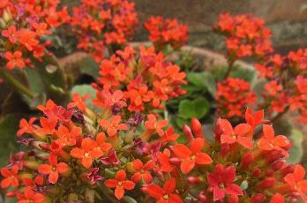
Provide Protection for all Genera and Species
Incentive
Access
Competitiveness
Progress
Incentivizes breeders for bringing improved varieties to the market
Gives growers access to new & improved varieties, opening national and international markets
Provides consumers with greater diversity and choices at reasonable prices
Boosts domestic plant breeding, access to improved foreign varieties for domestic breeding programs
Katie Burnett. Unsplash
TerraNova Nurseries
HitroMilanese: CC-BY-SA-3.0
Michalis Mantelos, Unsplash
Dahlia
Kalanchoe
Pixabay
Paweł Czerwiński, Unsplash
Osteospermum
Phlox
Heuchera
Felicia

Slide 15
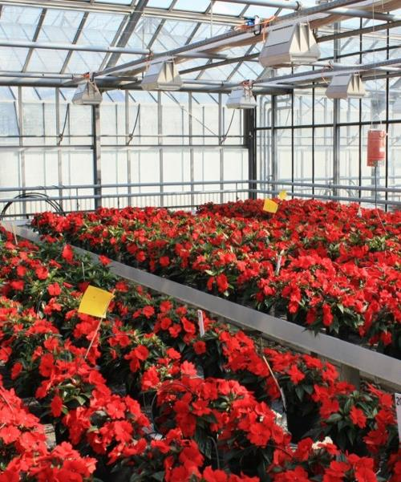
Minimum Distance
Each new candidate variety should be literally “new” to be able to get a reasonable market share or even develop its own market.
The candidate variety should be ‘sufficiently’ unique or ‘original’ as compared to the varieties already available on the market.
Allowing plagiaristic varieties on the market and even granting PBR protection for them weakens the PBR protection of innovative varieties.
Minimum Distance between varieties
must be
sufficiently broad.
Do not allow or support cosmetic breeding
Thomas leidereiter

Slide 16
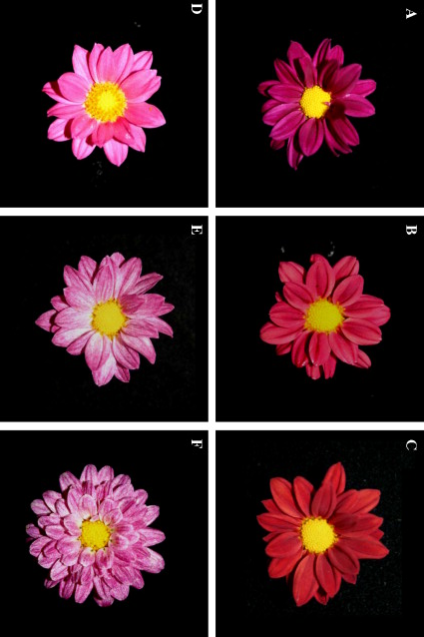
Essentially Derived Varieties (EDV)
Conventional breeding is the source of innovation and the backbone of the horticulture. It requires a significant human and financial investment
Initial Varieties serve as the basis for the development of mutants - natural or induced (NBT) and GMO varieties.
Mutants and GMOs may decrease the commercial success of their Initial Variety by competing in the same market segment.
A fair business environment needs to be established, where both the breeder of the Initial Variety and the breeders of the EDV receive a fair return on investment.
Protect original varieties
Scientia Horticulturae, Volume 123, Issue 4, Feb 2010, Pages 558-561

Slide 17
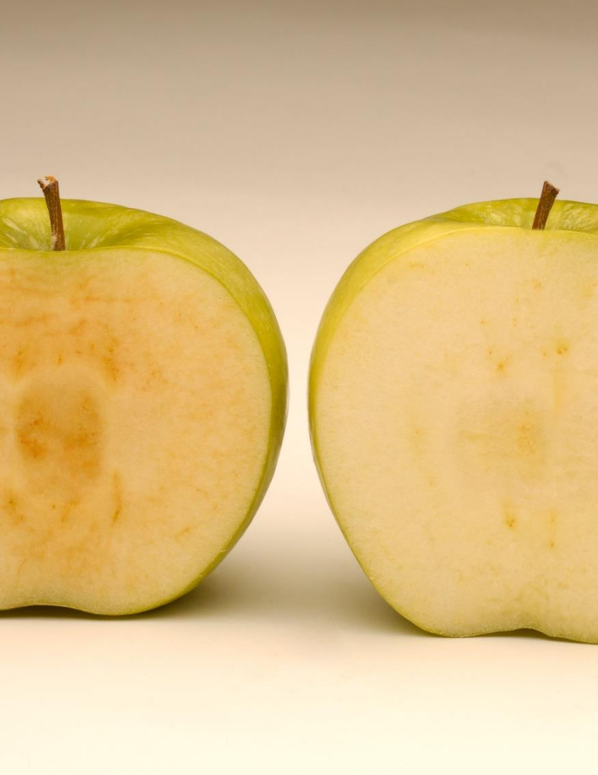
Essentially Derived Varieties (EDV)
All mutants, including
- natural
- induced by chemicals
- induces by x-ray
- developed by way of New Breeding Techniques
should be considered Essentially Derived Varieties.
It is then up to the parties to agree on commercial terms for exploitation of the EDV
Image: Traditional Golden Delicious apple (left) versus the Arctic variety (right).
Protect original varieties
Okanagan Specialty Fruits Inc.

Slide 18
Directly protect any plant material
The value of varieties is in their plants, flowers and fruits as well as products directly obtained from them.
All plant material should be protected directly (without a cascade) enabling the breeder to license production, sales, export, and import of plants, flowers and fruits and to control compliance within the supply chain.
Such sufficiently broad scope of protection would reflect the real commercial value of plant material and would lower transaction costs for breeders. It would protect breeders from infringements and the licensed growers from unfair competition.
Protect ALL
Plant Material
Alexander Andrews, Unsplash.com

Slide 19
Farmers’ Exemption (Nongmin)
Farmers’ exemption weakens the effectiveness of PBR for our crops, that are not subsistence crops but “business crops”
Example: A nongmin can purchase 1 PBR protected rose plant, propagate this multiple times and sell cut roses for many years, being liable to pay only a single royalty on the initial plant to the breeder. What constitutes small scale farming in agriculture can be much more significant for fruit and ornamental crops.
The average rural household farm of ca 8.74 mu (6,000 square meters) can provide space for more than 40,000 rose plants or 1,000 apple trees.
No Farmers’ (nongmin) Exemption for asexually reproduced horticultural crops
Doan Tuan, Unsplash.com

Slide 20
Provisional Protection
Creates a real incentive for breeders to launch their innovation at an early stage since they can control the exploitation of his variety and enforce their rights before the grant of the title
Benefits society, since the entire production and trade chain as well as consumers, receive early access to improved varieties
Effective provisional protection benefits licensed growers, whose production and sales planning depends on reliable market control by the breeder.
Providing full protection as of the date of the publication of the application...
Alex Loop, Unsplash.com

Slide 21
Variety Denomination
The variety denomination should be used to label both propagating and harvested material, because...
Consumers like to know what they buy
By using the variety denomination at the point of sales, consumers will benefit from transparency and enjoy the opportunity to acquire and remember their favorite variety
Using the variety denomination allows traceability up and down the production and trade chain, necessary for the consumer protection.
Raquel Martinez, Unsplash.com

Slide 22
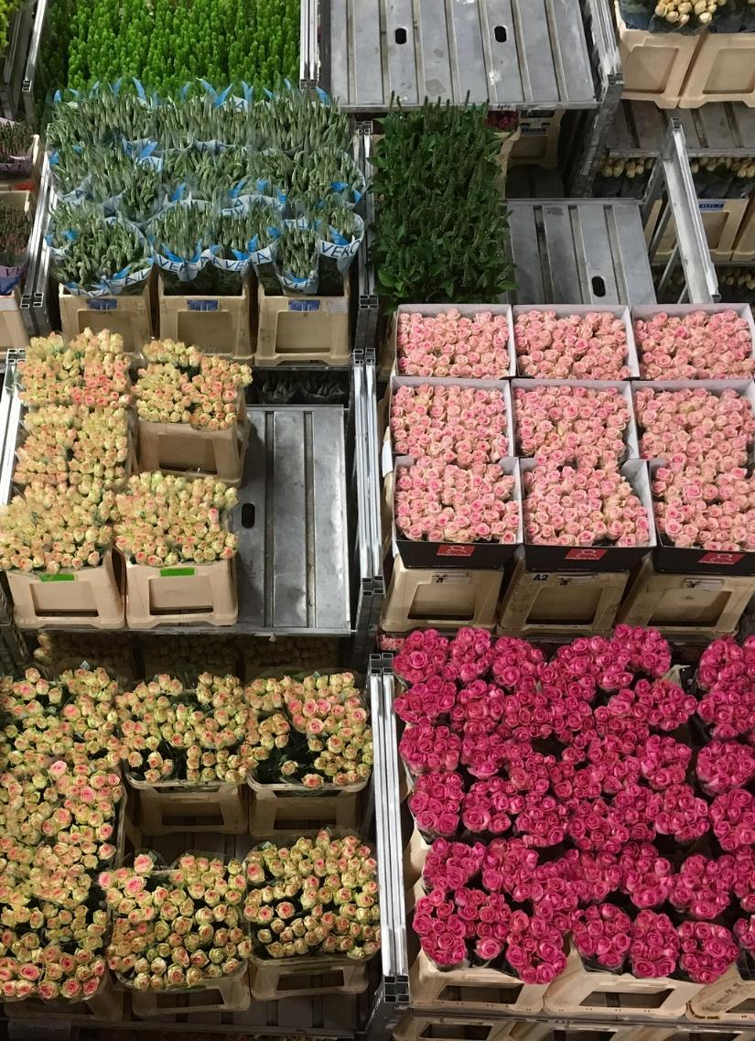
Import and Export of Plant Material
The import and export of propagating and harvested material of protected varieties into and out of China should require a permission of the title-holder.
Permission to import & export
Pixabay

Slide 23
Enforcement
A PBR title without effective enforcement mechanisms is worthless! Breeders need:
Sufficient information and access to premises
Fast and reliable proceedings
Specialized Courts
Full compensation of costs of proceedings
Effective border measures
Deterrent sanctions and damages
Effective
enforcement
mechanisms
Plush Design, Unsplash.com

Slide 24
Fair cooperation will bring success and prosperity for all!

Slide 25
Thank you!
CIOPORA Administrative Office
Deichstraße 29
20459 Hamburg, Germany
edgar.krieger@ciopora.org
Tel.: +49 40 555 63 702
Fax: +49 40 555 63 703

